Slide 1
Rapid Application Development
using Large Language Models
Speaker Name, Title | Event/Date

Slide 2
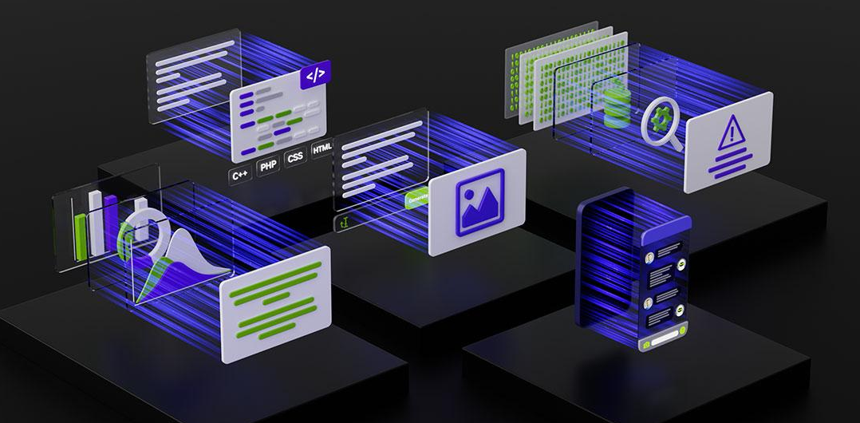
Large Language Models
Backbones for Language Understanding
Backbones for language tasks, including classification and generation.
https://www.nvidia.com/content/dam/en-zz/Solutions/lp/large-language-models-ebook/nvidia-llm-ebook-og.jpg

Slide 3
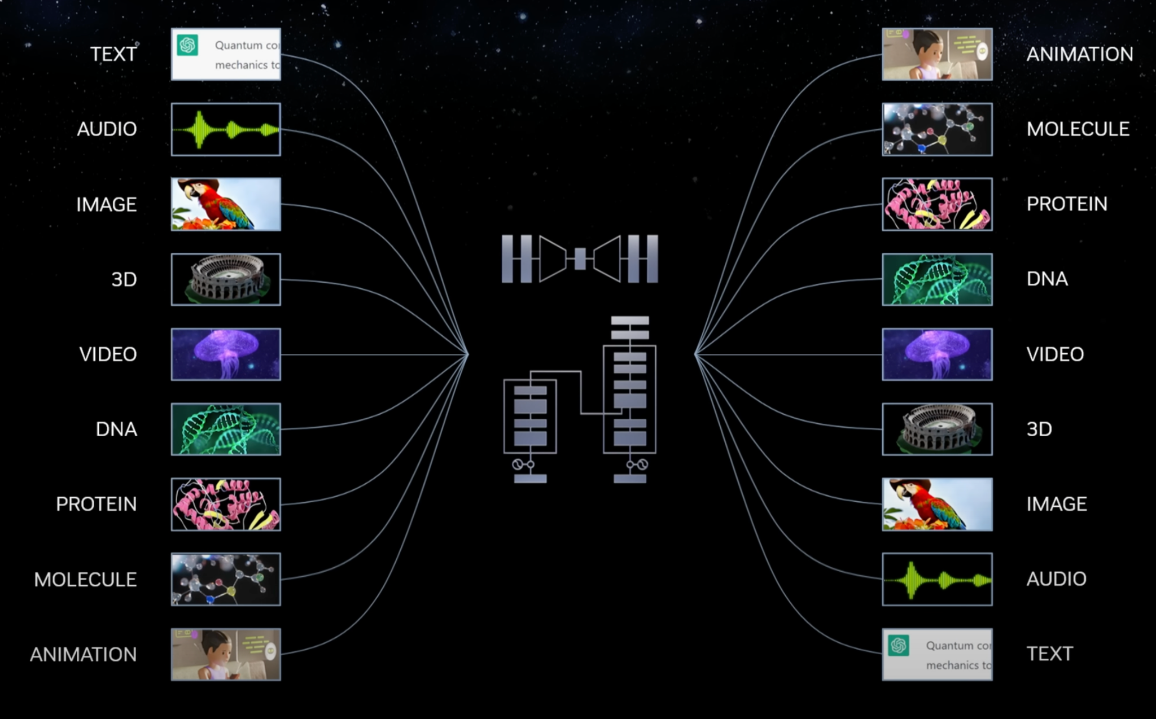

Sequence Modeling
Core Component of Generative AI
3

Slide 4
Course Objectives
Rapid LLM Application Development
Understand How LLMs Work
Architectures
Intuitions
Design Paradigms
Use LLMs To Solve Interesting Problems
Language Reasoning
Text Generation
Chat Assistants

Slide 5




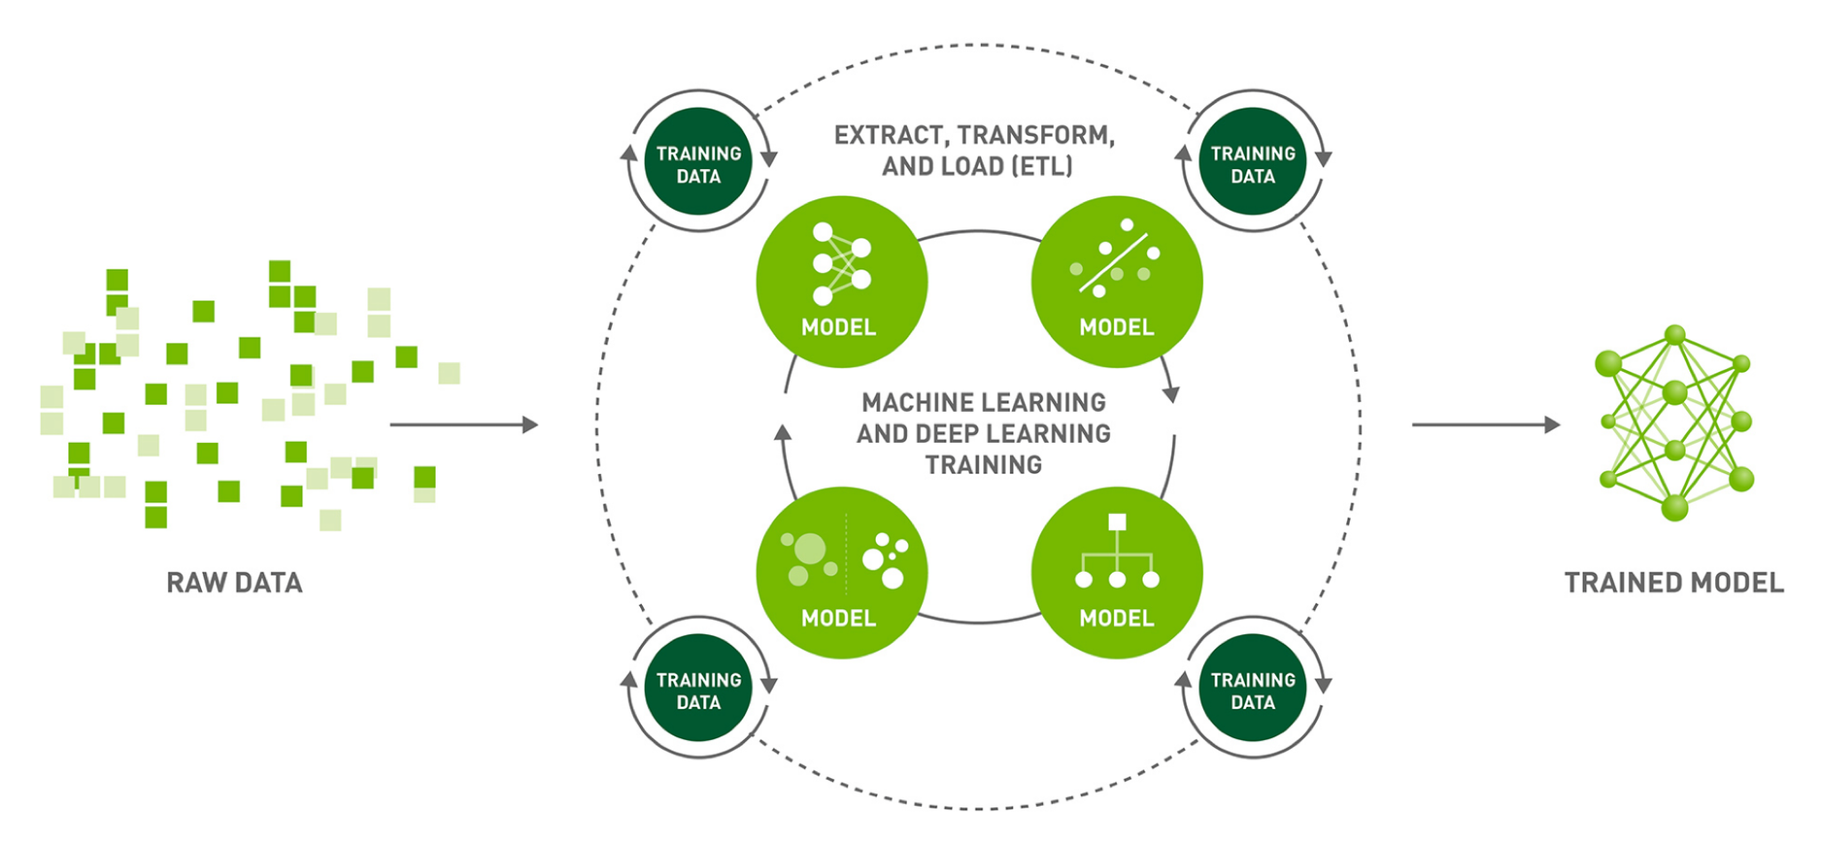
Prerequisites
Fundamentals of Deep Learning
Intermediate Python Required

Slide 6


Core Tools
Open-Source LLM Ecosystem

Slide 7

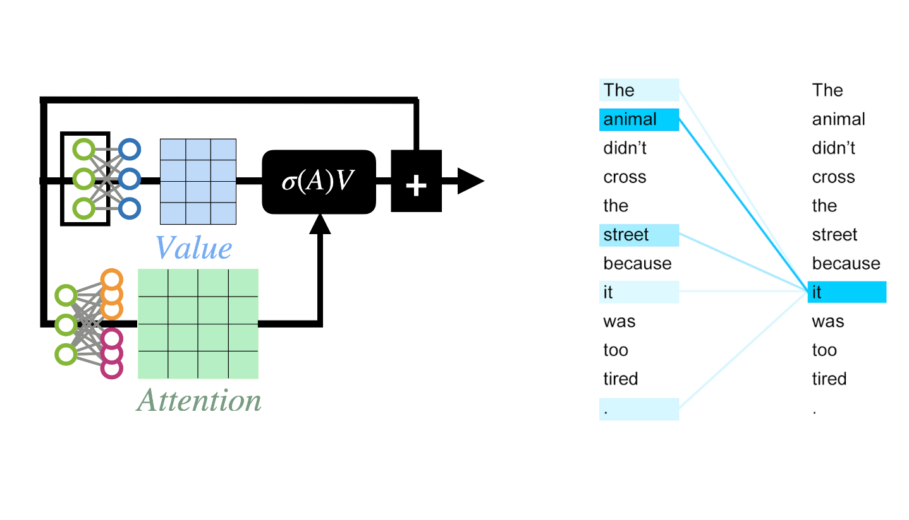
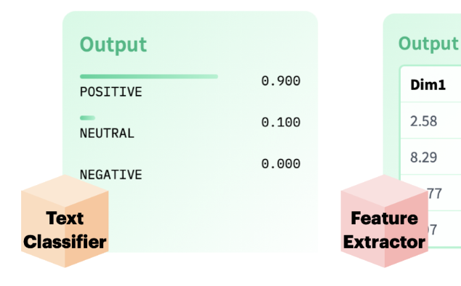
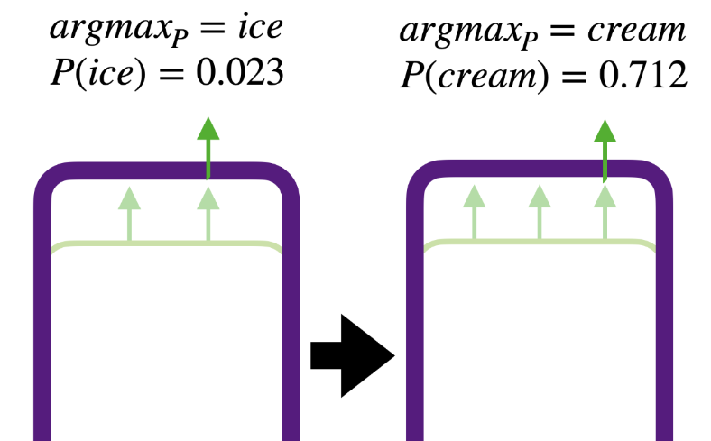
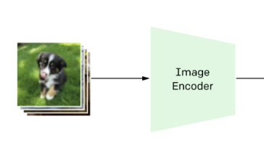
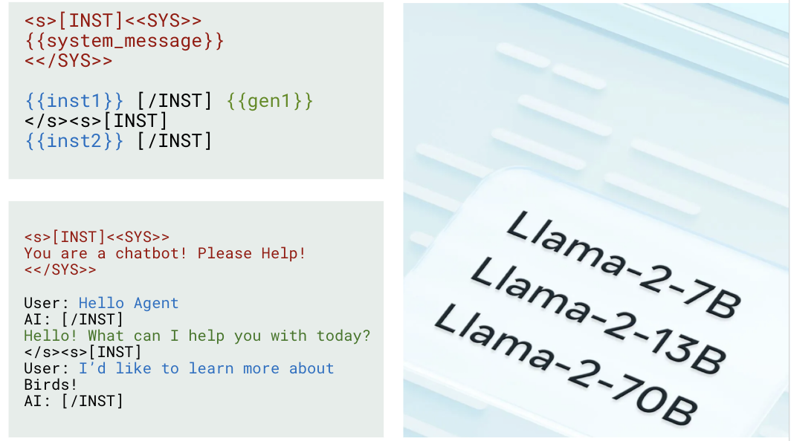
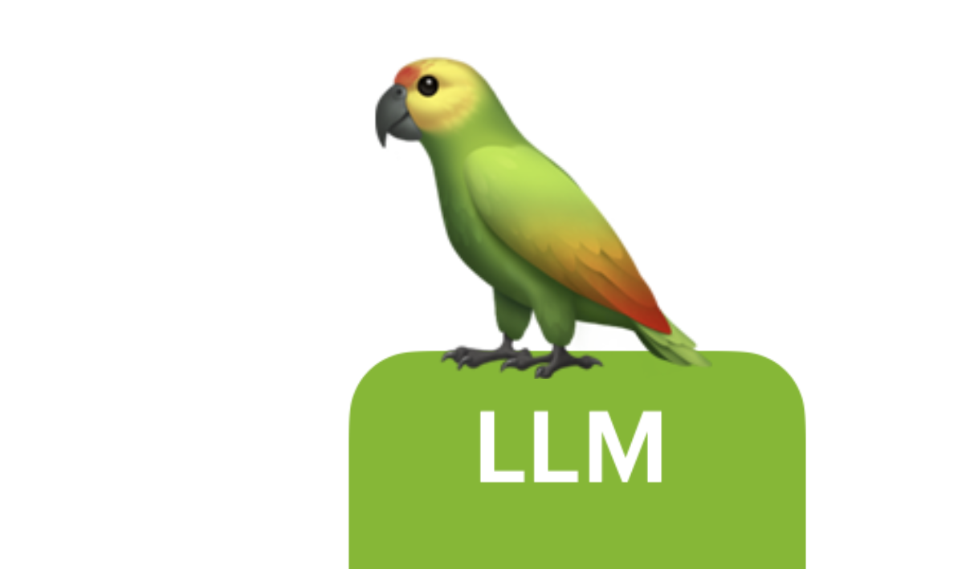
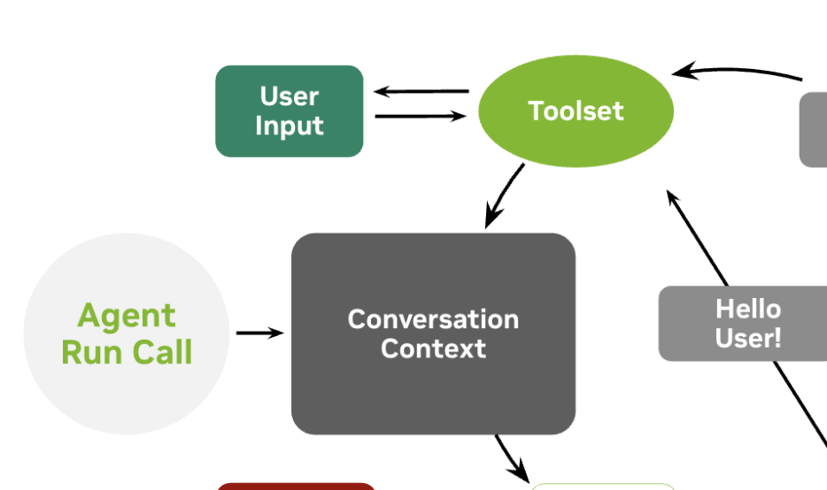
Course Schedule
What’s The Plan?
Getting Started
Transformer Intuitions
Encoder Tasks
Seq2Seq
Multimodality
Text Generation
Stateful LLMs
Agent Assessment

Slide 8
Part 1: From DL To LLMs
• | From Deep Learning to Language Modeling
• | Pulling In Our First Model
• | Model Architecture Intuitions
• | Using Encoders For Encoding

Slide 9
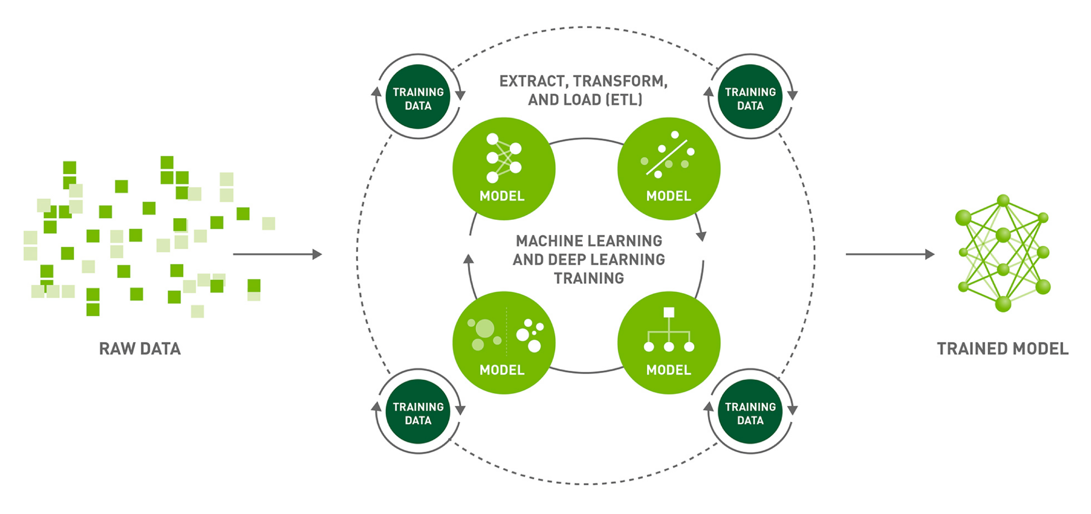
Deep Learning
(Machine Learning with Deep Models)
https://www.nvidia.com/en-us/deep-learning-ai/software/rapids/

Slide 10
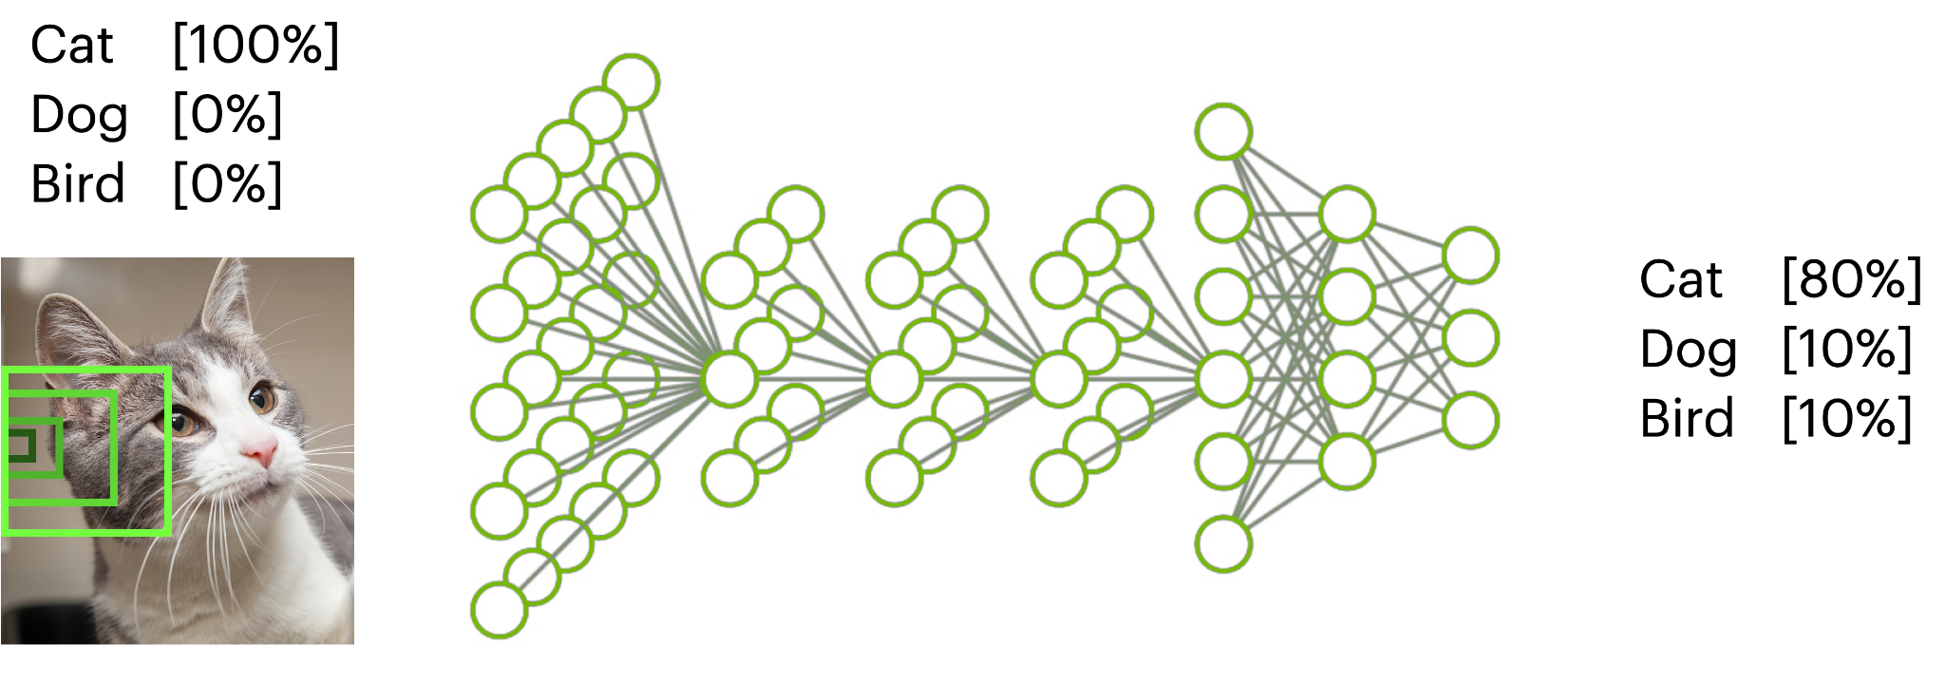
Deep Learning
(Machine Learning with Deep Models)
https://www.rover.com/blog/can-my-cat-eat-salt/

Slide 11
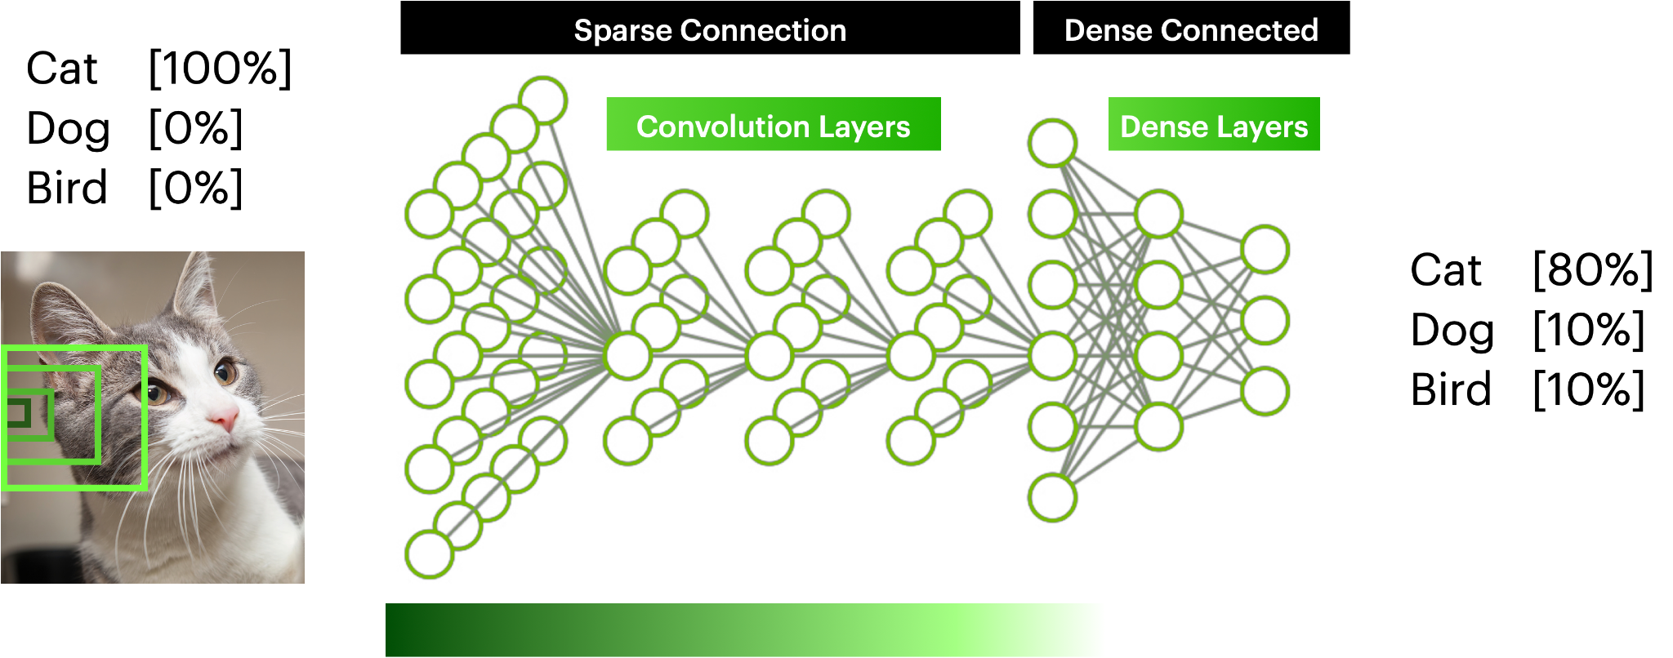
Deep Learning
(Machine Learning with Deep Models)
https://www.rover.com/blog/can-my-cat-eat-salt/

Slide 12
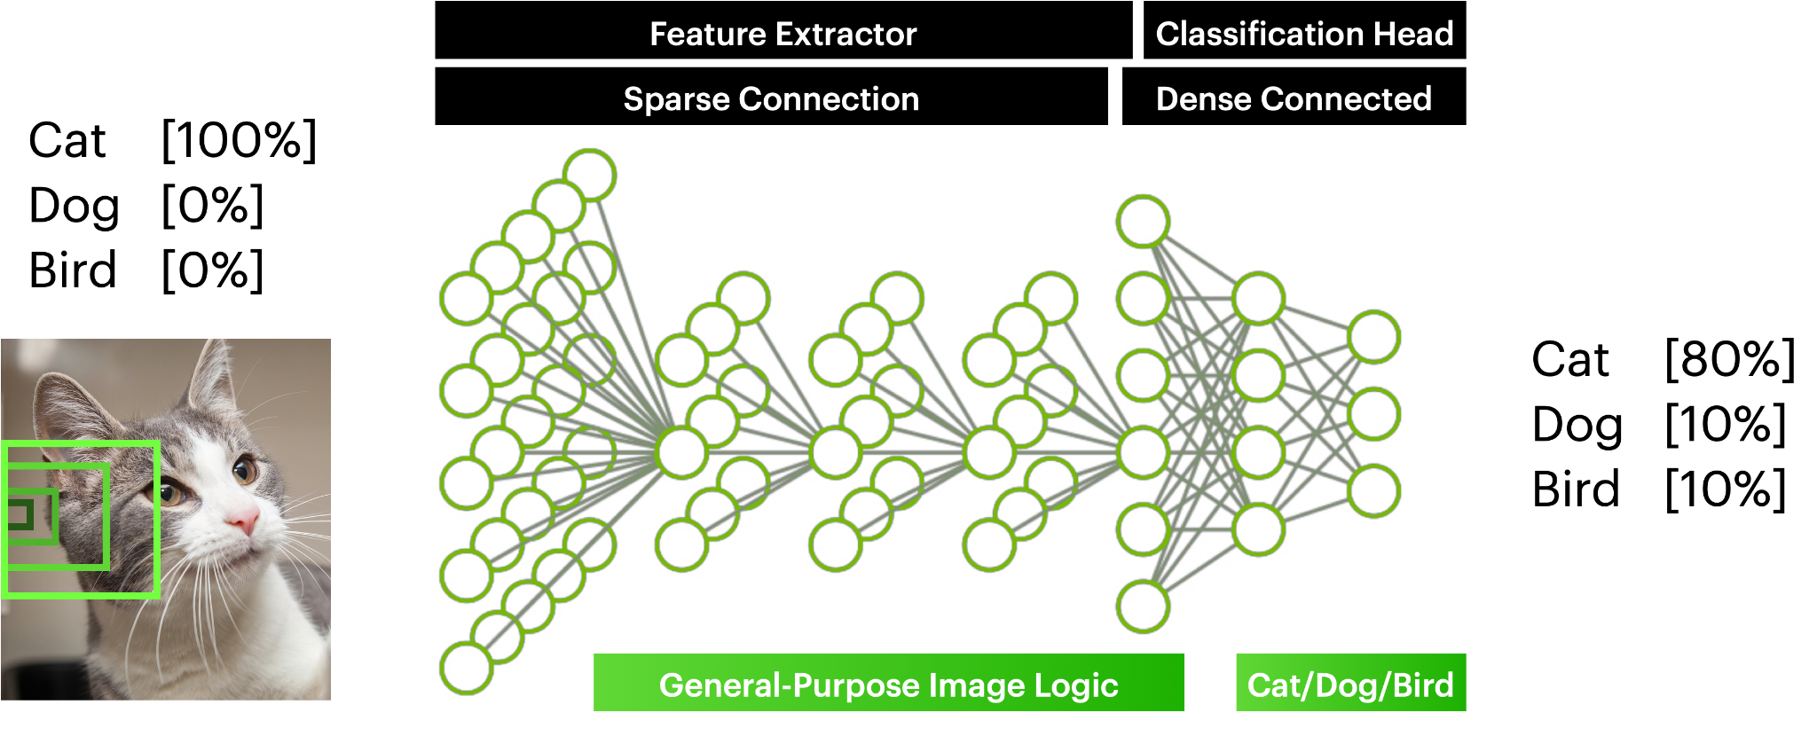
Deep Learning
(Machine Learning with Deep Models)
https://www.rover.com/blog/can-my-cat-eat-salt/

Slide 13
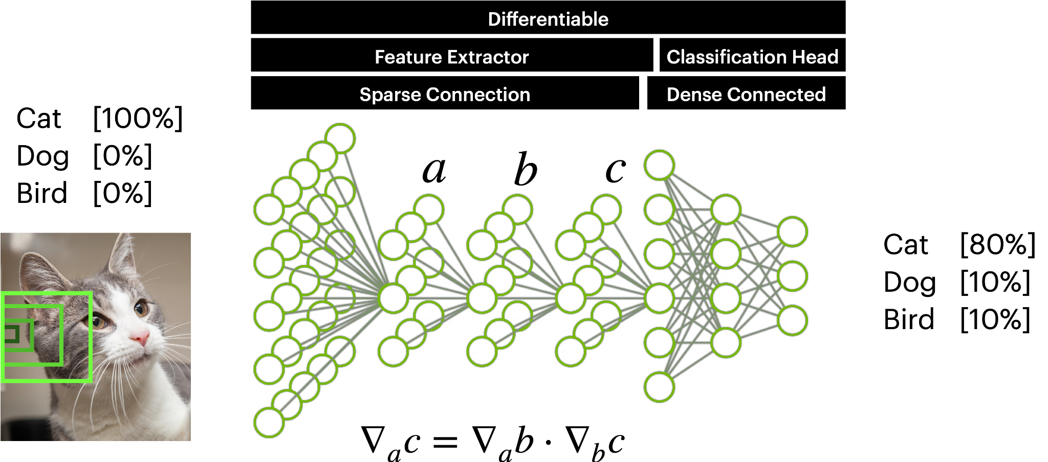
Deep Learning
(Machine Learning with Deep Models)
https://www.rover.com/blog/can-my-cat-eat-salt/

Slide 14
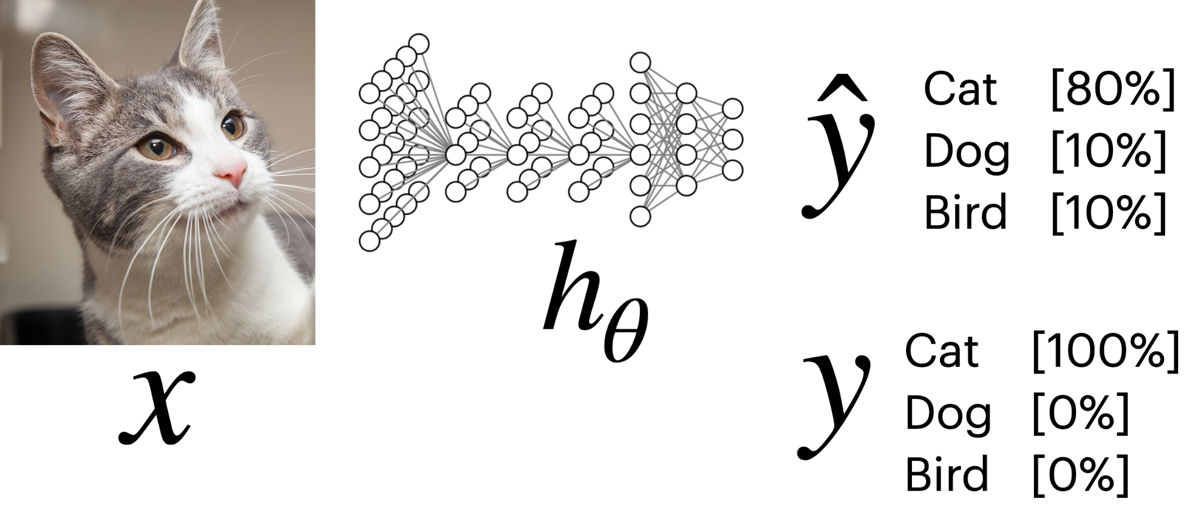
Deep Learning
(Machine Learning with Deep Models)
https://www.rover.com/blog/can-my-cat-eat-salt/

Slide 15
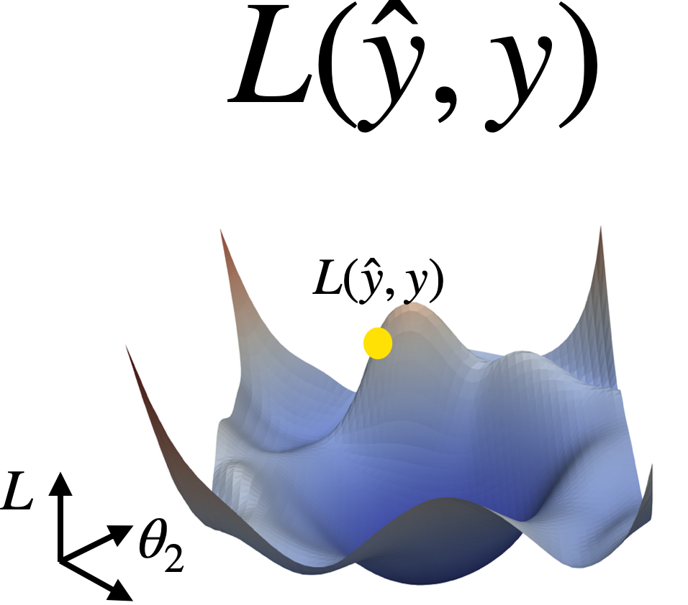
Deep Learning
(Machine Learning with Deep Models)
https://www.rover.com/blog/can-my-cat-eat-salt/

Slide 16
Deep Learning
(Machine Learning with Deep Models)
https://www.rover.com/blog/can-my-cat-eat-salt/

Slide 17
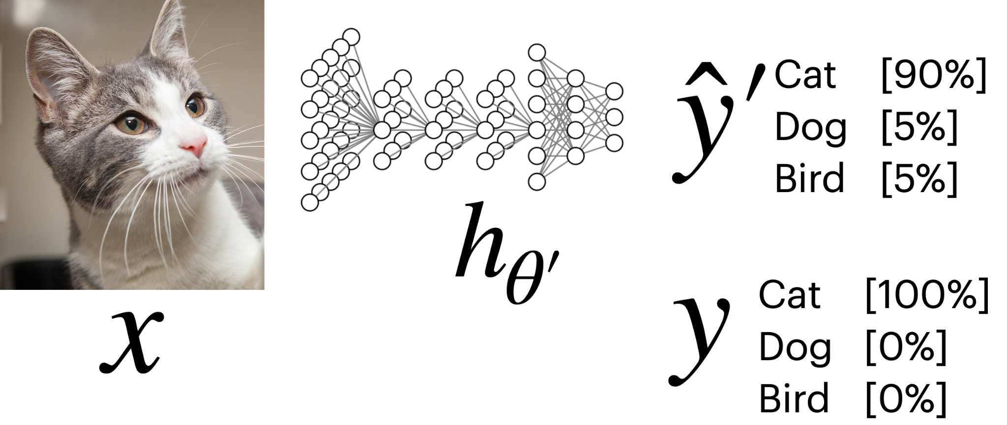
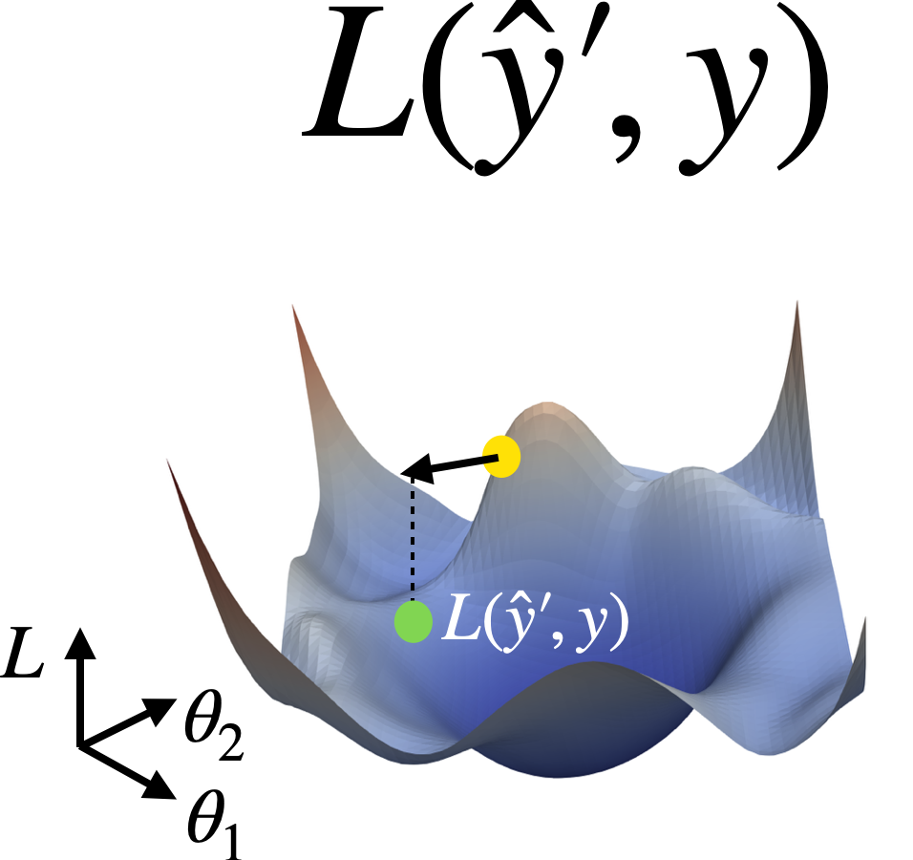
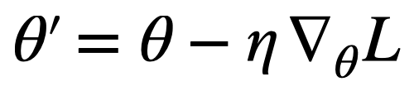
Deep Learning
(Machine Learning with Deep Models)
https://www.rover.com/blog/can-my-cat-eat-salt/

Slide 18
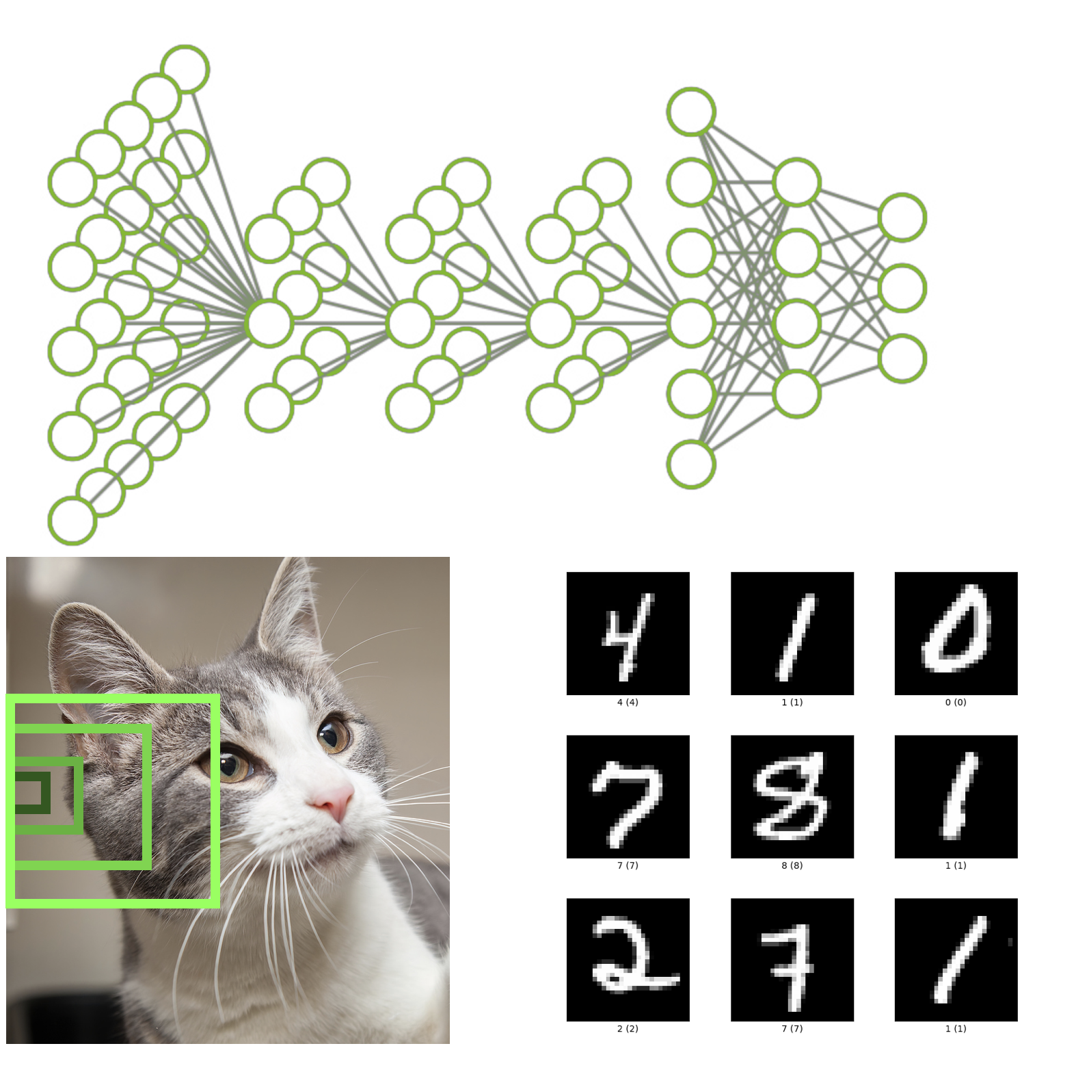
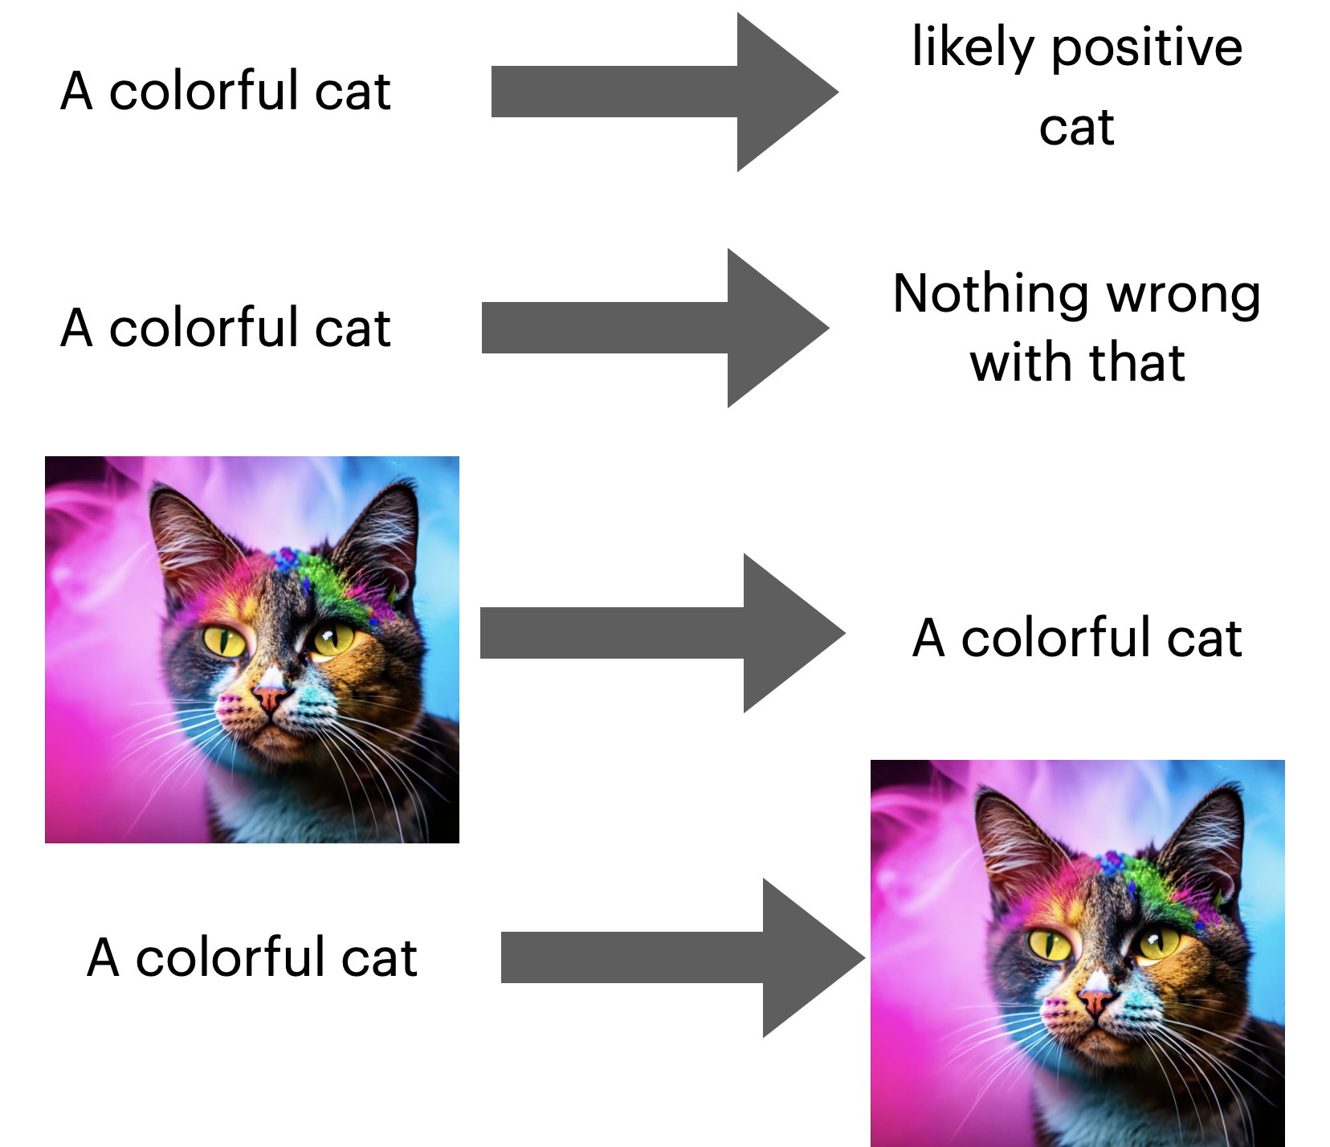
From Deep Learning to LLMs
Our Goal For The Course
Fundamentals of Deep Learning
Language Reasoning

Slide 19
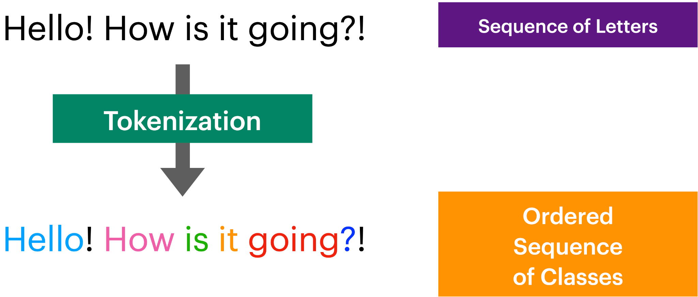
What Is Language?
Discrete Labels?

Slide 20
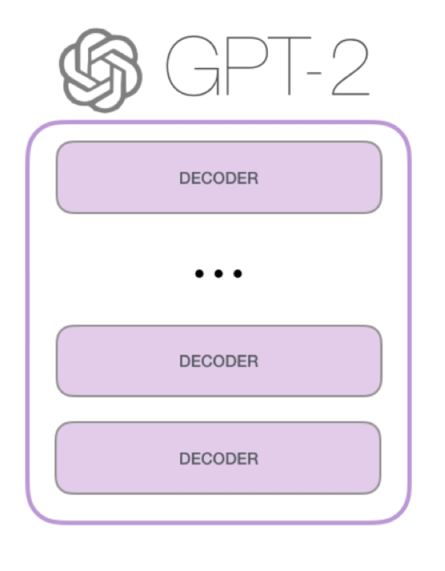
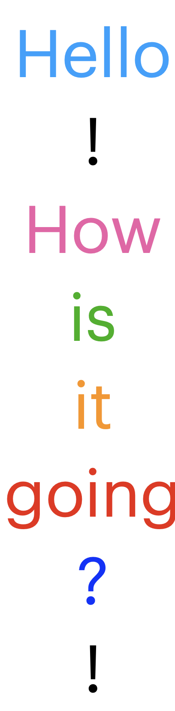
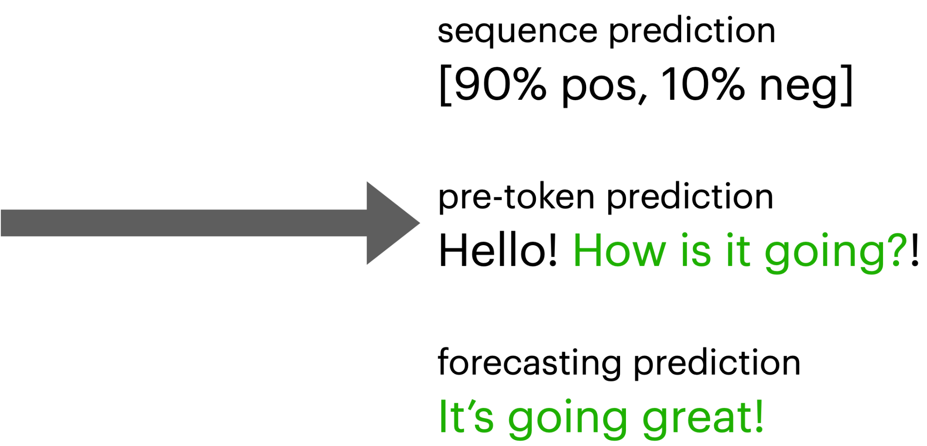
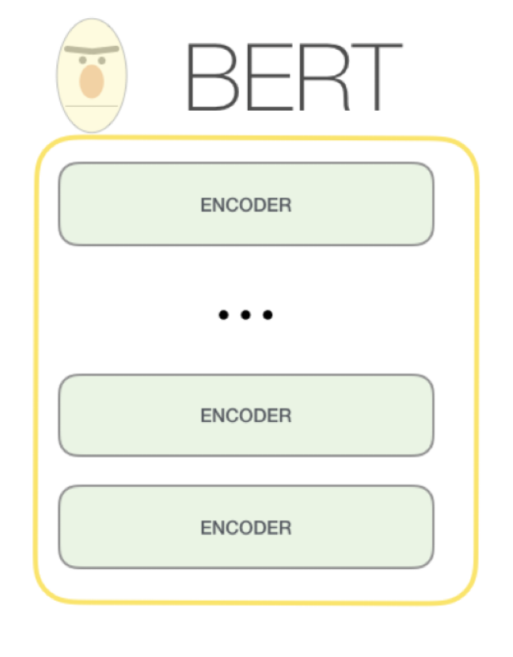
The Base Formulation
Dealing With Language As An Input
http://jalammar.github.io/illustrated-gpt2/

Slide 21
Part 1: From DL To LLMs
• | From Deep Learning to Language Modeling
• | Pulling In Our First Model
• | Model Architecture Intuitions
• | Using Encoders For Encoding

Slide 22
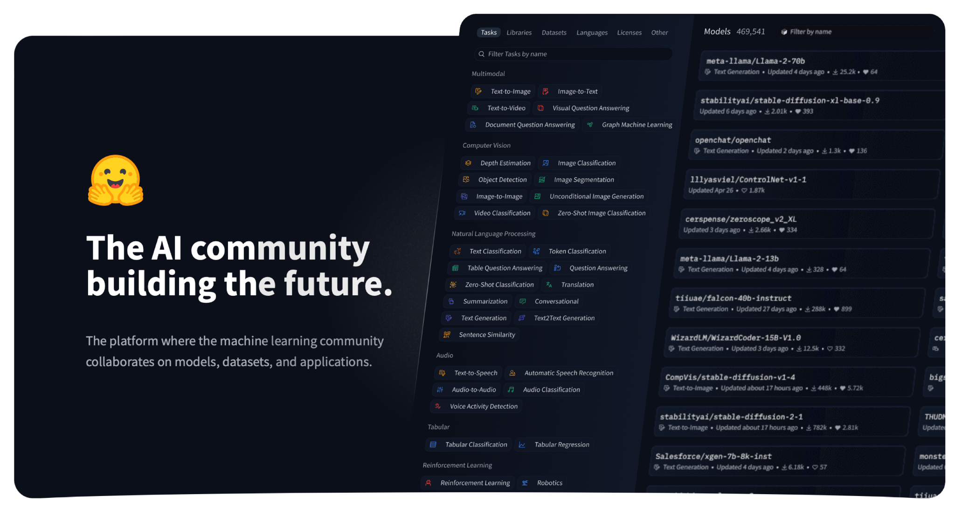
HuggingFace
Open-Source Large Model Community

Slide 23





HuggingFace
Open-Source Large Models
Large Open-Sourced Repository
Very easy to use, write to, pull from
So many models!!
Amazing For Experimentation
See what all can be done!
See how others have done things!
Use their models for your use-cases sometimes
https://huggingface.co/models

Slide 24
HuggingFace
Open-Source Large Models
Large Open-Sourced Repository
Very easy to use, write to, pull from
So many models!!
Amazing For Experimentation
See what all can be done!
See how others have done things!
Use their models for your use-cases sometimes
Big Catch
Check EULA licenses per-model per-dataset
Might have to recreate system or train yourself
https://huggingface.co/models

Slide 25
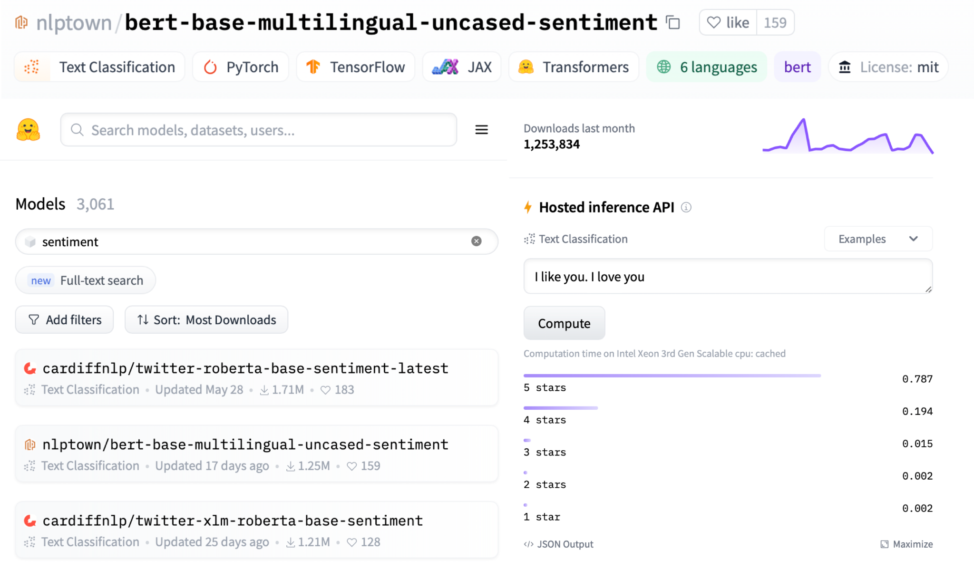
Pulling In A Simple Model
Lightweight BERT Model

Slide 26
Pulling In A Simple Model
Lightweight BERT Model

Slide 27
Pulling In A Simple Model
Lightweight BERT Model

Slide 28
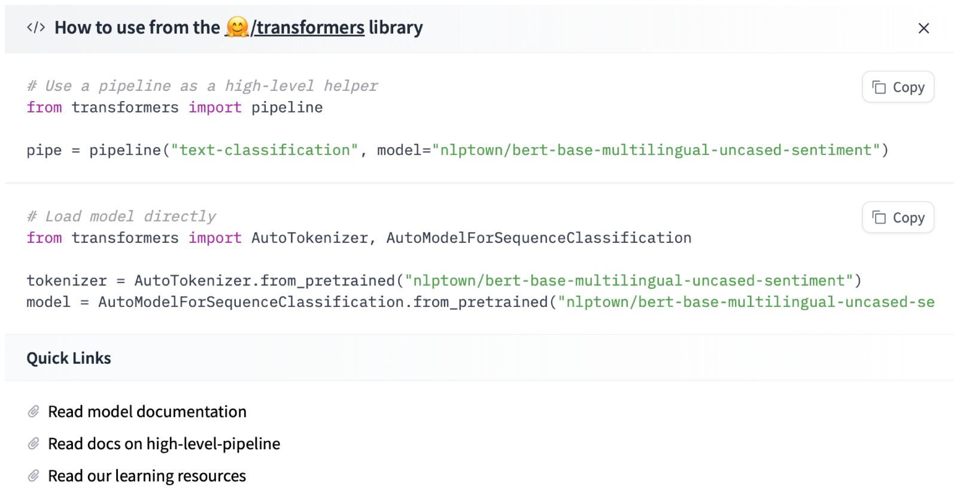
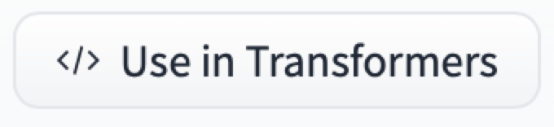
Pulling In A Simple Model
Lightweight BERT Model

Slide 29
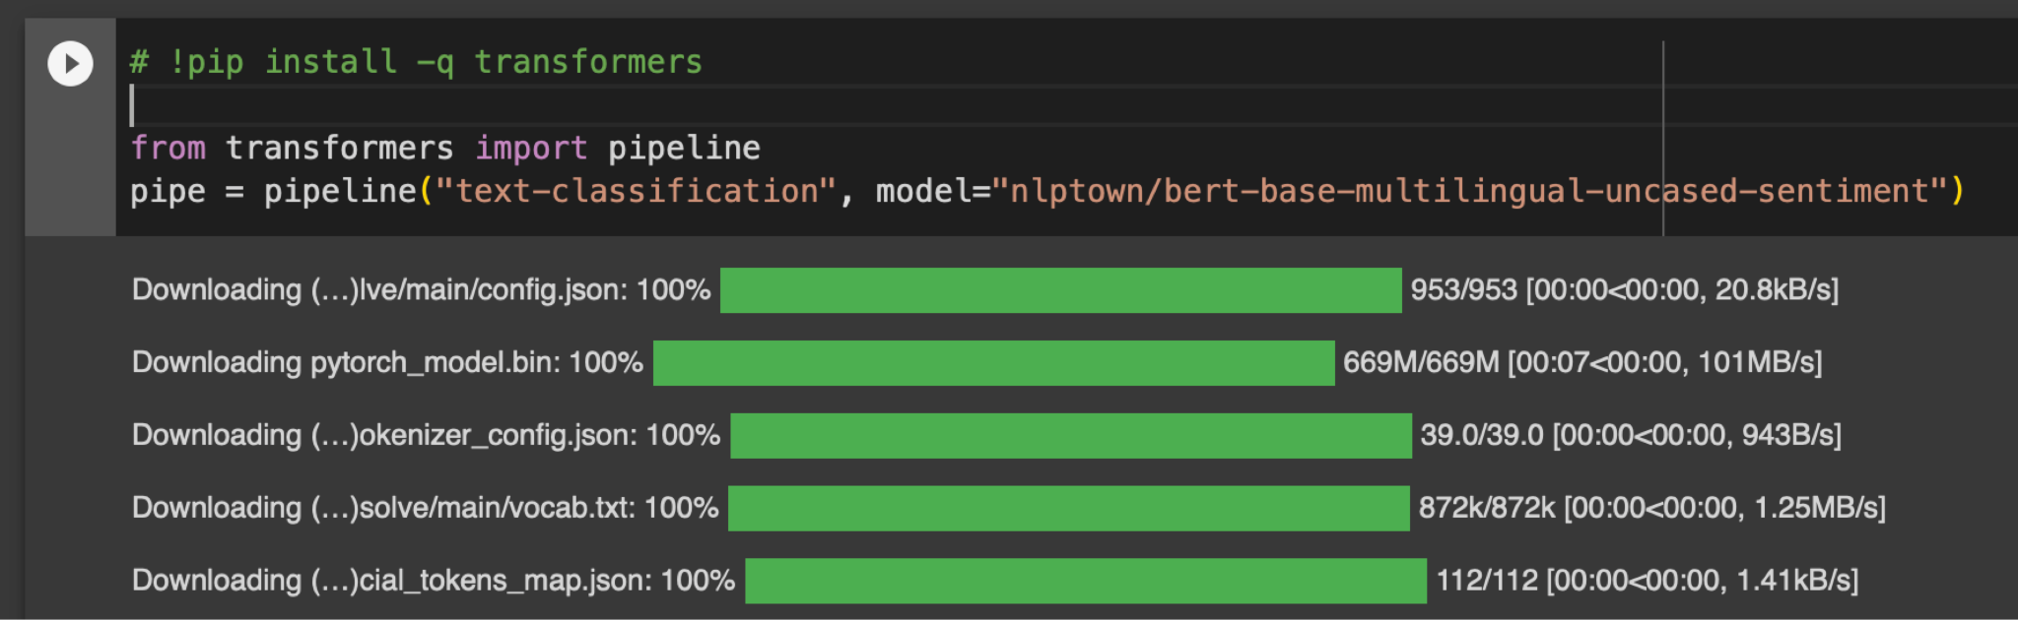
Pulling In A Simple Model
Lightweight BERT Model

Slide 30
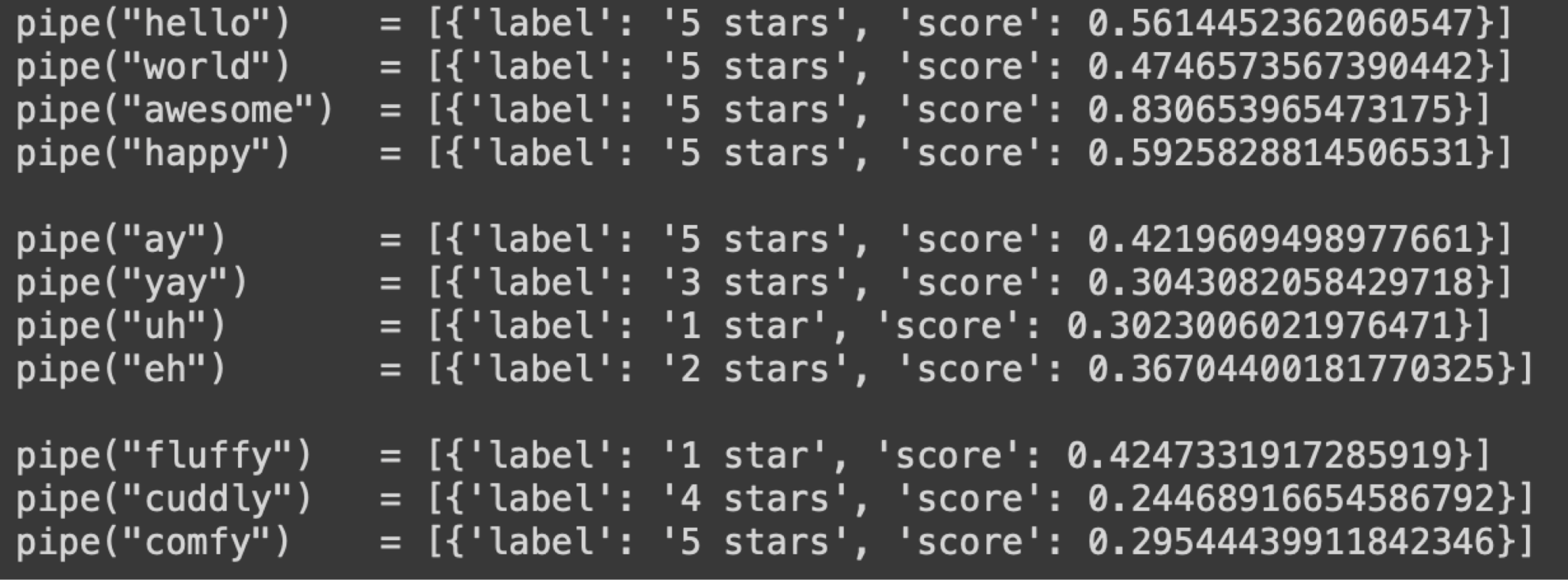
Running Your Simple Model
Lightweight BERT Model

Slide 31
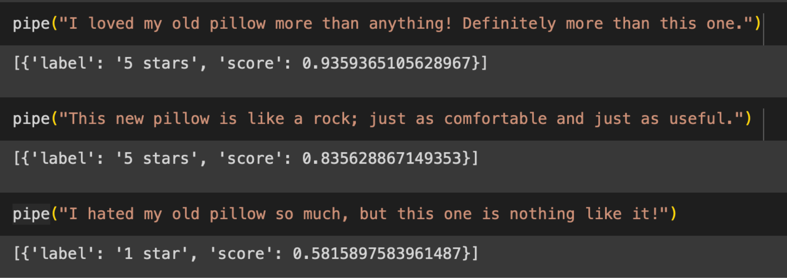
Running Your Simple Model
Lightweight BERT Model

Slide 32
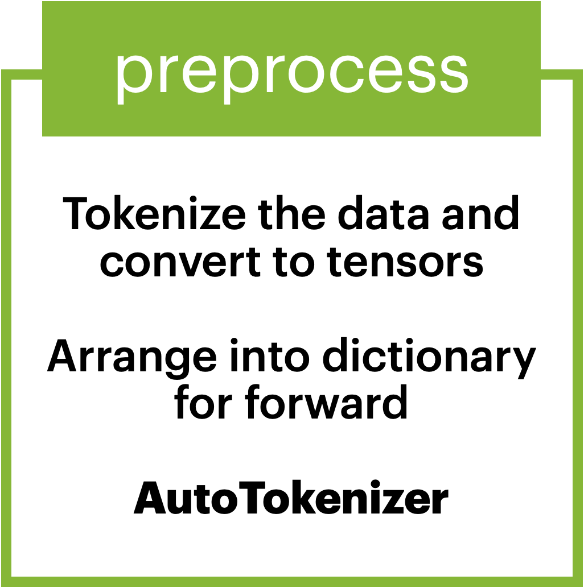
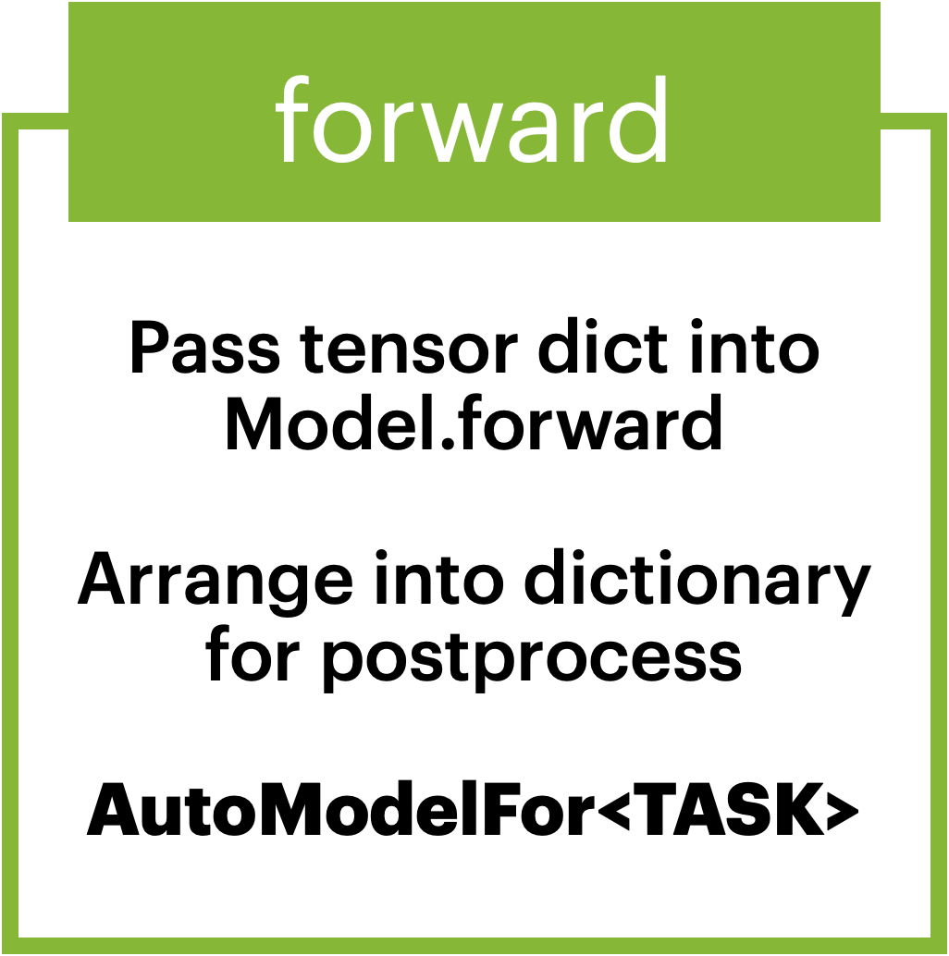
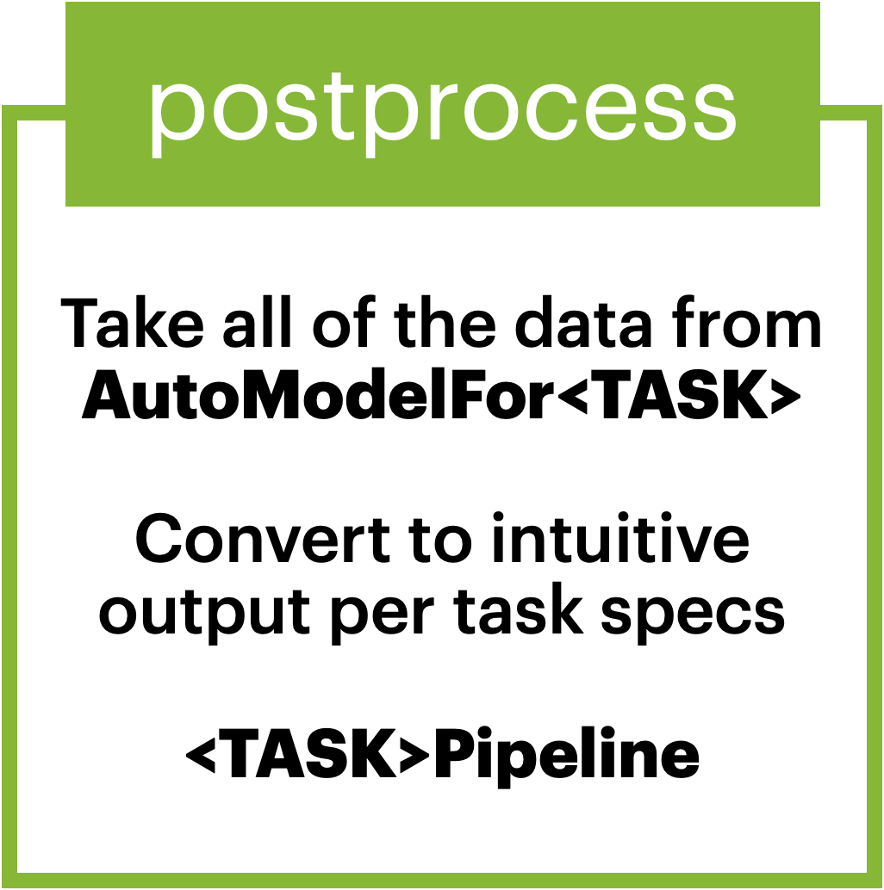
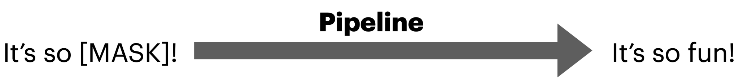
Pipeline Components
Input -> Tensor -> Tensor -> Output

Slide 33
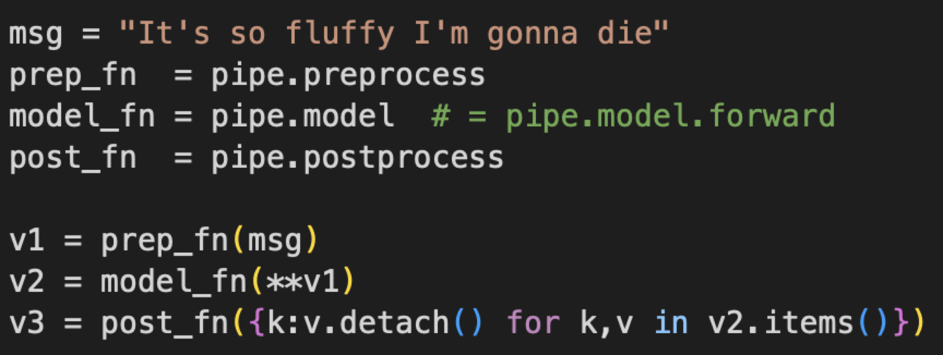
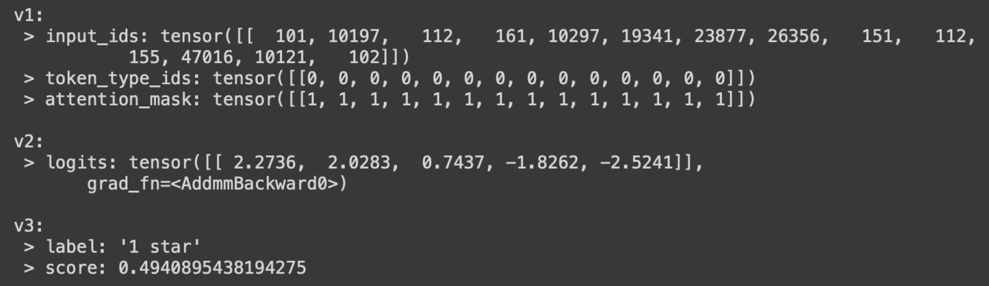
Pipeline Components
Input -> Tensor -> Tensor -> Output

Slide 34
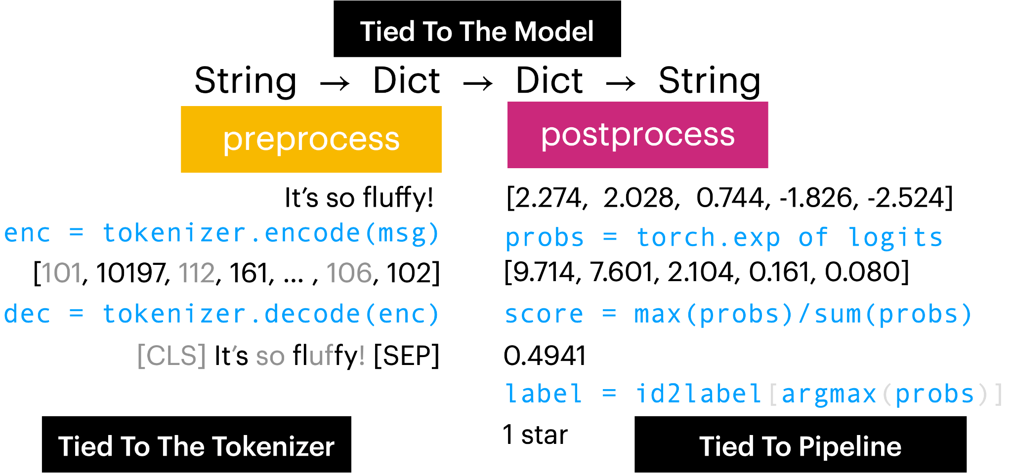
Pipeline Components
Input -> Tensor -> Tensor -> Output

Slide 35
Pipeline Components
Input -> Tensor -> Tensor -> Output

Slide 36
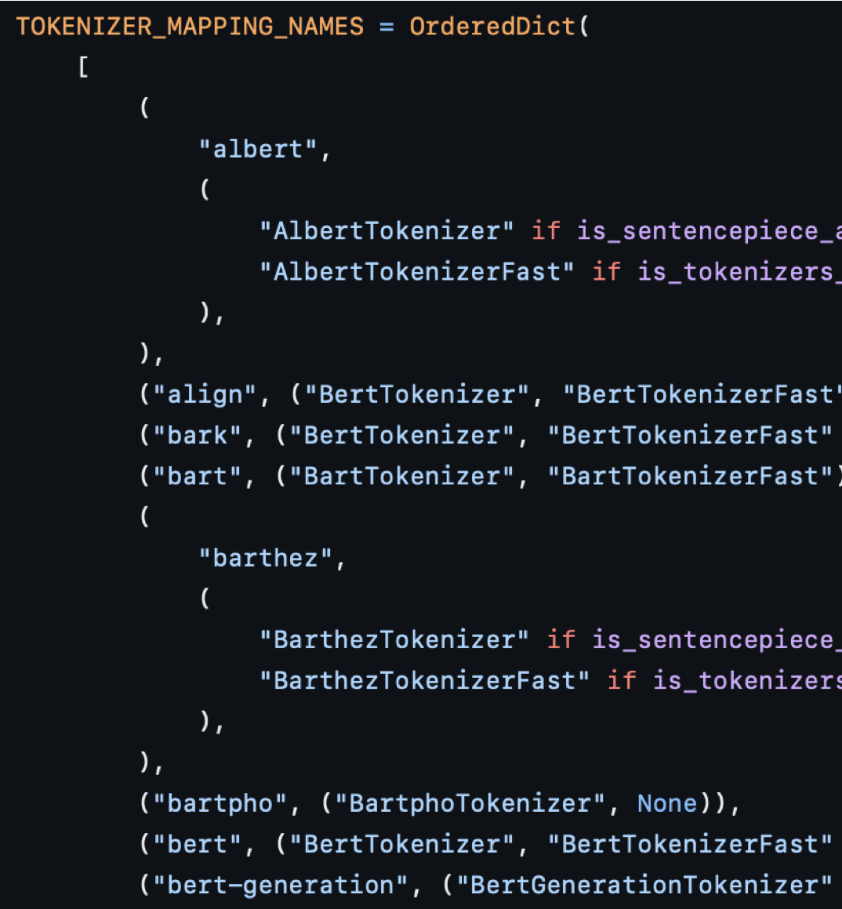
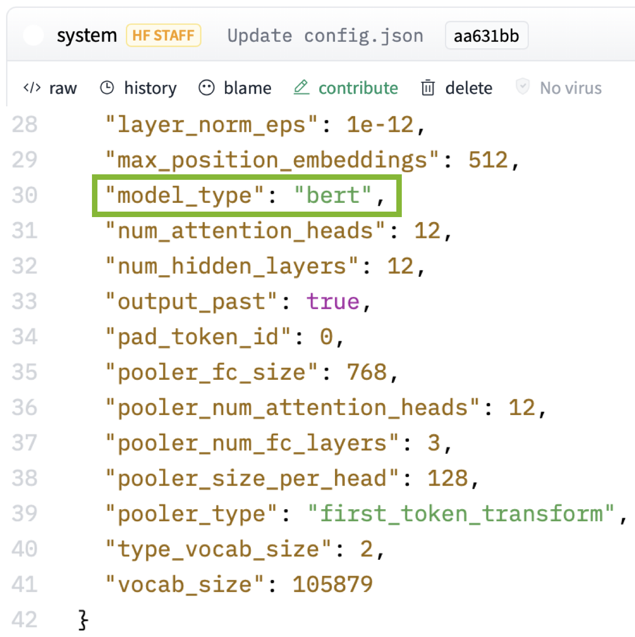
Pipeline Components
Input -> Tensor -> Tensor -> Output

Slide 37
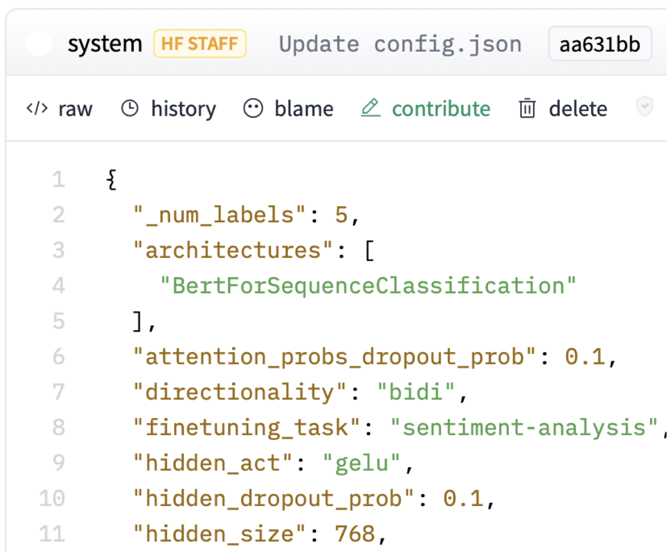
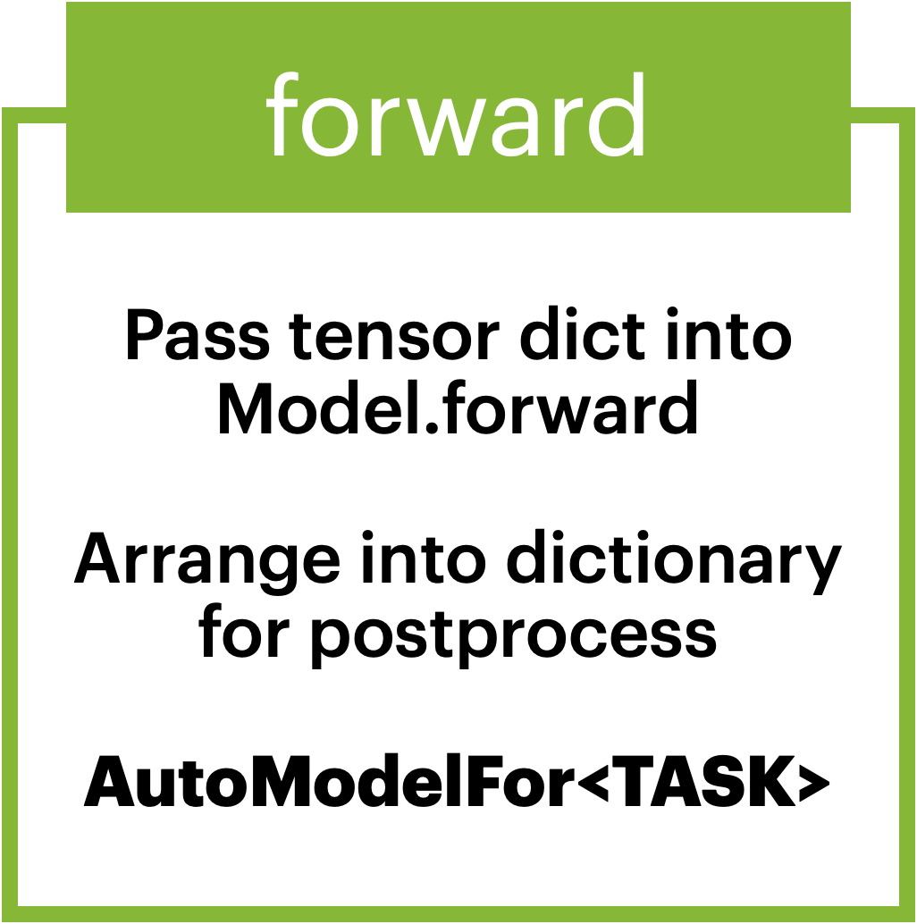
Pipeline Components
Input -> Tensor -> Tensor -> Output

Slide 38
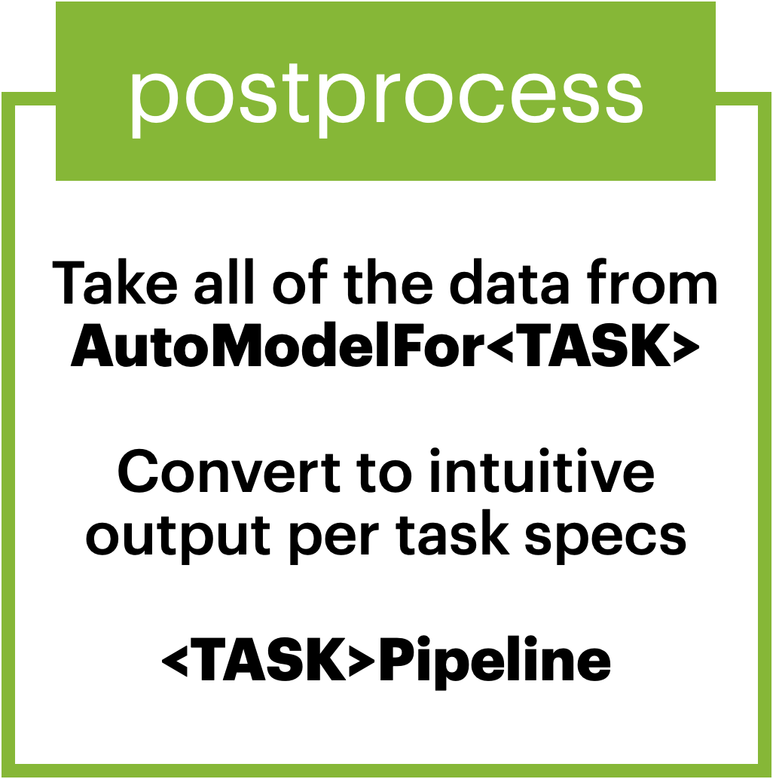
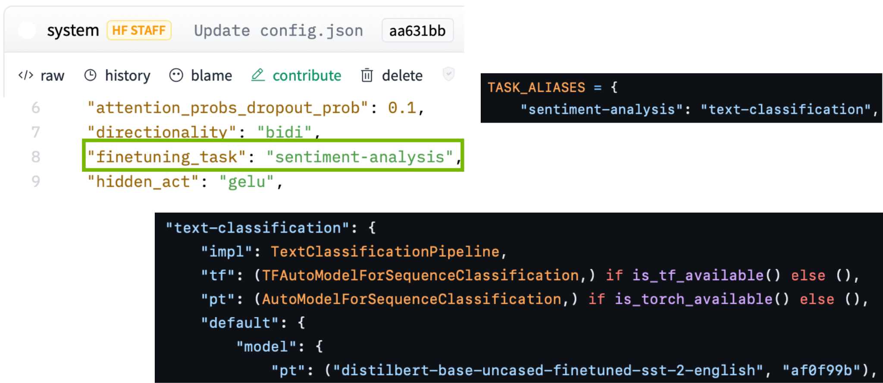
Pipeline Components
Input -> Tensor -> Tensor -> Output

Slide 39
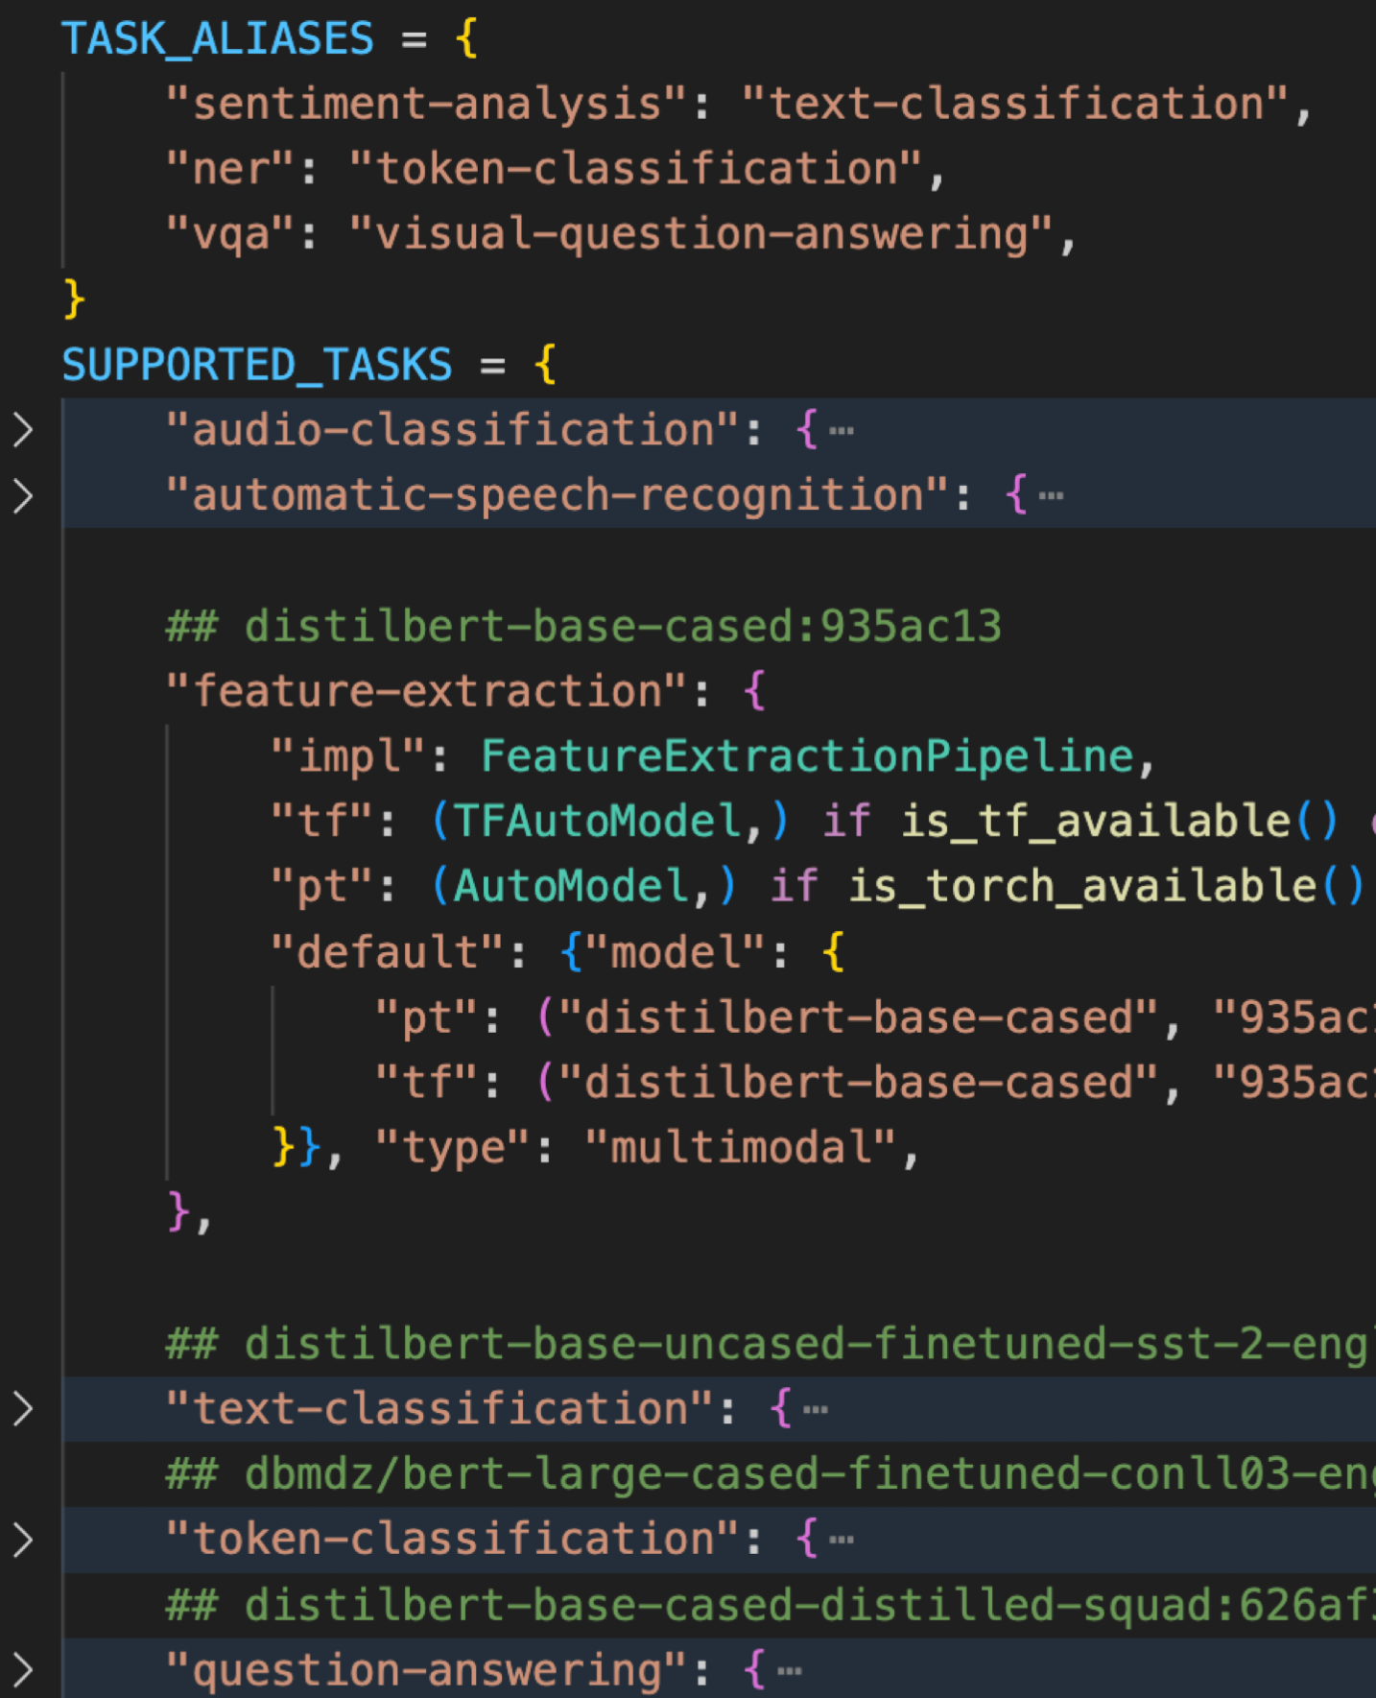
HF Pipeline Options
Automatic End-to-End Pipelines
HuggingFace Automatic Task Support
Based on a given task:
Pulls in default models, tokenizers, etc.
Pulls in default Pipeline/postprocess.
Offers Backend Options (“pt”, “tf”, etc.)
Recommends Default Model

Slide 40
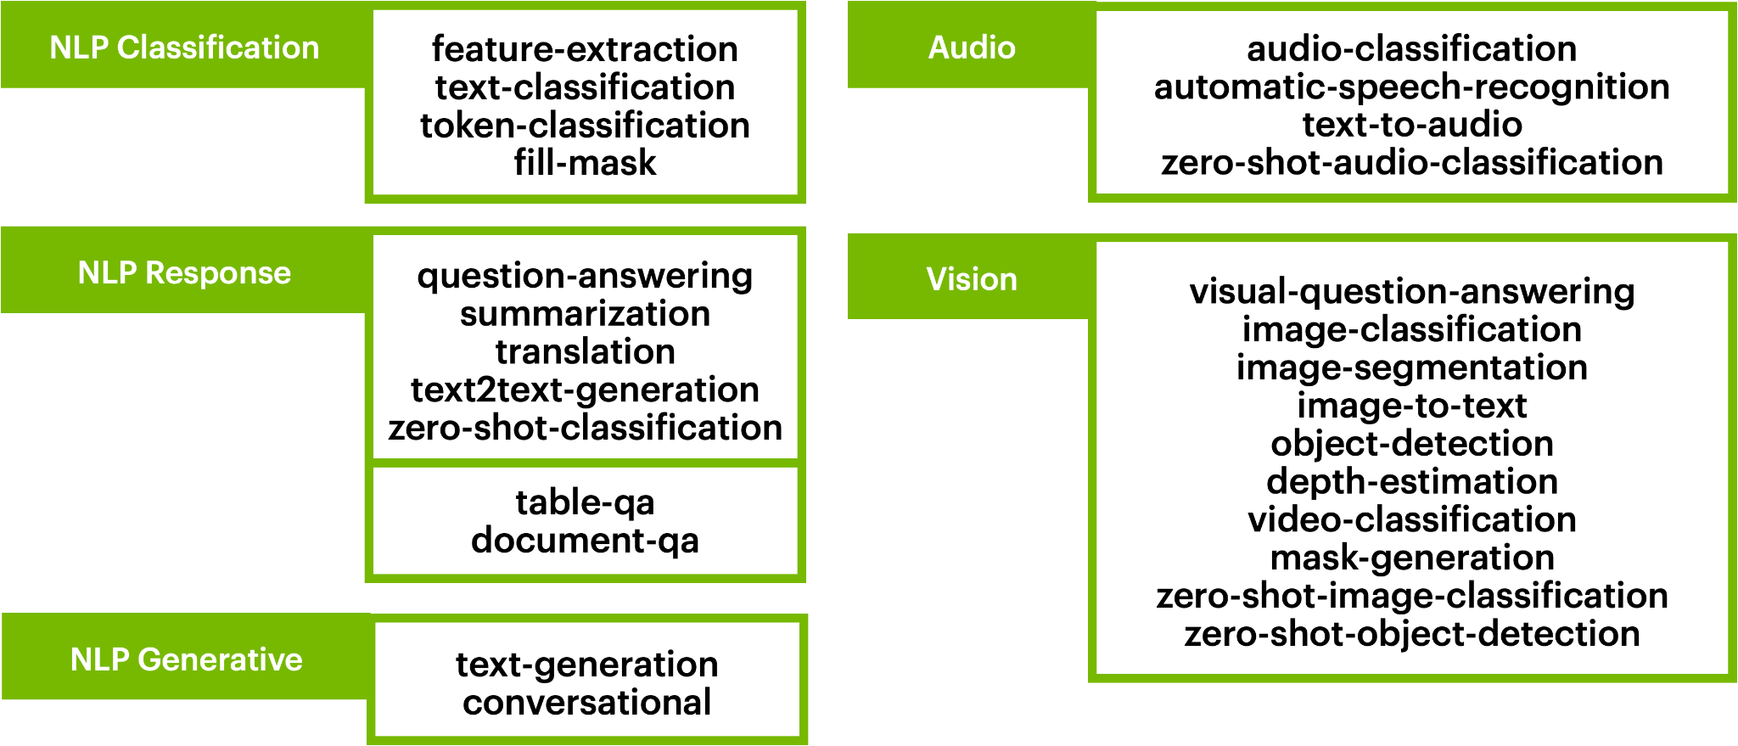
HF Pipeline Options
Automatic End-to-End Pipelines

Slide 41
Part 1: From DL To LLMs
• | From Deep Learning to Language Modeling
• | Pulling In Our First Model
• | Model Architecture Intuitions
• | Using Encoders For Encoding

Slide 42
Our Problem Space
Ordered Sequence of Classes

Slide 43
The Base Formulation
Dealing With Language As An Input
Sequence-Level Prediction
Per-Token Prediction
Generation (Forecasting)
http://jalammar.github.io/illustrated-gpt2/

Slide 44
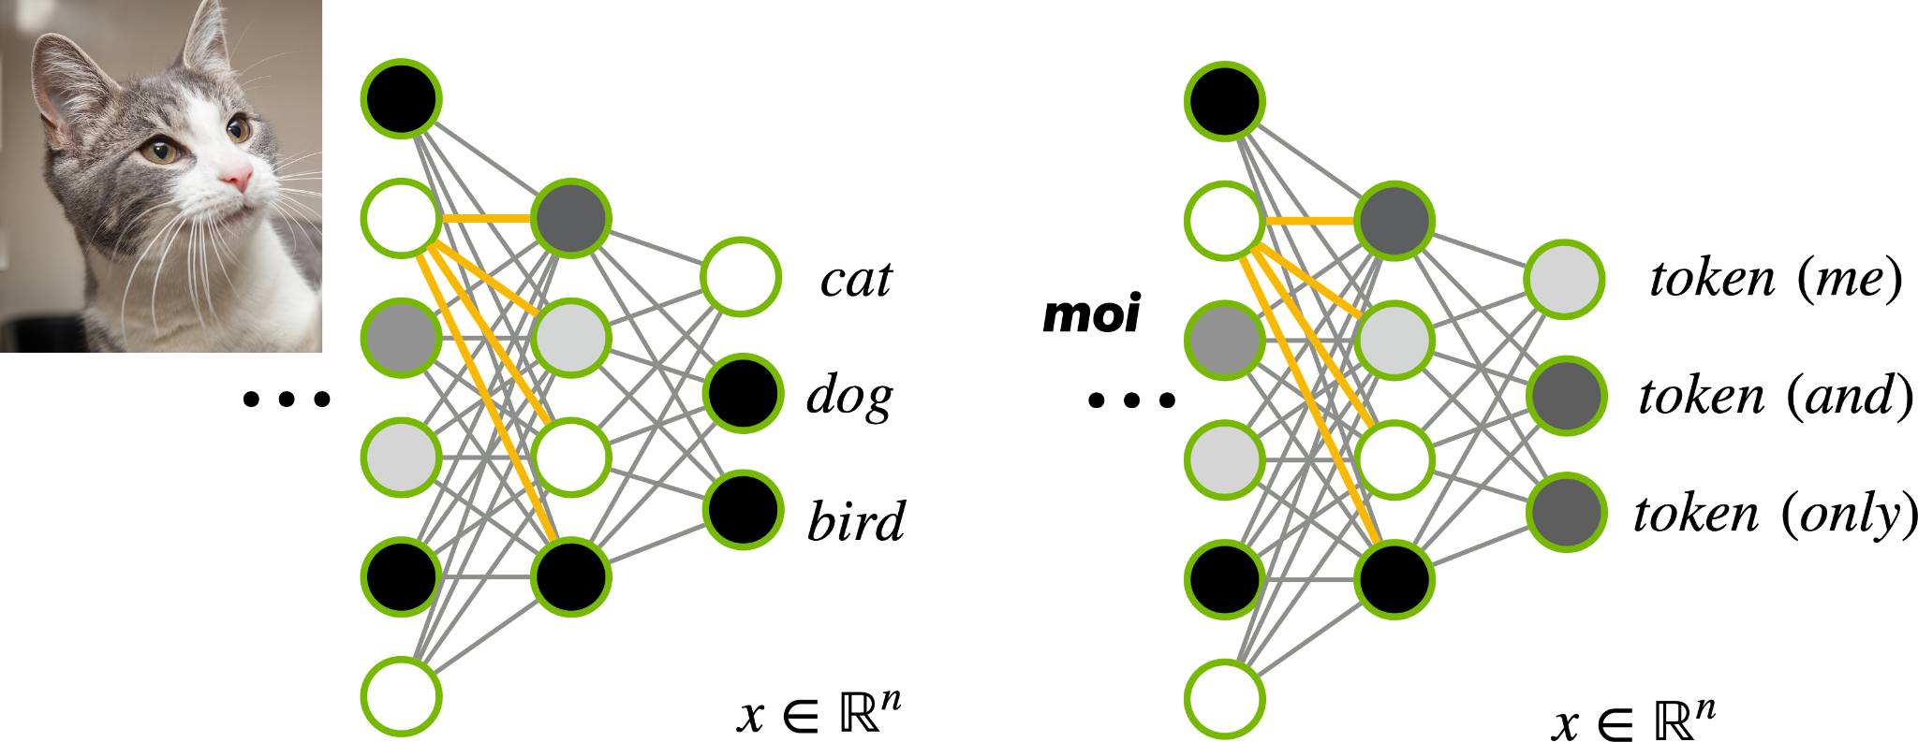
Dealing With Classes
Ordered Sequence of Classes
https://www.rover.com/blog/can-my-cat-eat-salt/

Slide 45

Dealing With Classes
Ordered Sequence of Classes

Slide 46
Dealing With Classes
Ordered Sequence of Classes

Slide 47

Dealing With Classes
Ordered Sequence of Classes

Slide 48
Dealing With Classes
Ordered Sequence of Classes

Slide 49


Dealing With Ordered Classes
Ordered Sequence of Classes
Per-Token
Feed-Forward
Per-Token Predictions

Slide 50
Dealing With Ordered Classes
Ordered Sequence of Classes
Token-Level Reasoning Ok
Sequence-Level Reasoning Necessary
Per-Token
Feed-Forward
Per-Token Predictions

Slide 51

Transformers for Sequence Reasonings
Ordered Sequence of Classes

Slide 52

Transformers for Sequence Reasonings
Ordered Sequence of Classes

Slide 53

Transformers for Sequence Reasonings
Ordered Sequence of Classes

Slide 54

Transformers for Sequence Reasonings
Ordered Sequence of Classes

Slide 55

Transformers for Sequence Reasonings
Ordered Sequence of Classes

Slide 56

Transformers for Sequence Reasonings
Ordered Sequence of Classes

Slide 57

Transformers for Sequence Reasonings
Ordered Sequence of Classes

Slide 58


Transformers Intuition
Attention Is All You Need
https://blog.research.google/2017/08/transformer-novel-neural-network.html?m=1

Slide 59

Transformer Value Add
Natural Sequence Reasoners
Lightweight Entry Interface via Attention
Residual Connection To Enforce Ordering
Interpretable and Transferable Representation

Slide 60

“Encoder” Transformers In Practice
What Does SOTA Look Like?
https://huggingface.co/blog/bert-101

Slide 61


BERT Model
Powerful Encoder Model
Pretraining
Encoder: Encodes n-sequence into n-encoding.
Trained on Masked Language Modeling (MLM).
Internet-Scale Pre-Training.
Just embeddings and transformer blocks.
Used as language-reasoning backbone.
Fine-tuning
https://arxiv.org/pdf/1810.04805v2.pdf

Slide 62

From Transformer to BERT
Necessary Modifications
https://arxiv.org/pdf/1810.04805v2.pdf

Slide 63

From Transformer to BERT
Necessary Modifications
Problem: Need Deeper Reasoning
On same data representation? Multi-Headed Attention
https://arxiv.org/pdf/1810.04805v2.pdf

Slide 64

From Transformer to BERT
Necessary Modifications
Problem: Need Deeper Reasoning
On same data representation? Multi-Headed Attention
Need more representations? Multiple Transformer Layers
https://arxiv.org/pdf/1810.04805v2.pdf

Slide 65

From Transformer to BERT
Necessary Modifications
Problem: Need Deeper Reasoning
On same data representation? Multi-Headed Attention
Need more representations? Multiple Transformer Layers
Problem: Volatile gradients behavior, distribution shifts.
Layer Normalization (as seen in BERT)
Gaussian Error Linear Unit (GELU) (as seen in BERT)
Dropout During Training (as seen in BERT)
https://arxiv.org/pdf/1810.04805v2.pdf

Slide 66

From Transformer to BERT
Necessary Modifications
Problem: Need Deeper Reasoning
On same data representation? Multi-Headed Attention
Need more representations? Multiple Transformer Layers
Problem: Volatile gradients behavior, distribution shifts.
Layer Normalization (as seen in BERT)
Gaussian Error Linear Unit (GELU) (as seen in BERT)
Dropout During Training (as seen in BERT)
Problem: Network too deep; Gradients are vanishing
Residual Connections
https://arxiv.org/pdf/1810.04805v2.pdf

Slide 67

BERT Constructed
From Transformer to BERT
https://huggingface.co/blog/bert-101

Slide 68
Part 1: From DL To LLMs
• | From Deep Learning to Language Modeling
• | Pulling In Our First Model
• | Model Architecture Intuitions
• | Using Encoders For Encoding

Slide 69
HF Pipeline Options
Automatic End-to-End Pipelines

Slide 70

Natural Encoder Tasks
From n-sequence Encodings
feature extraction
token classification
mask filling
text classification

Slide 71

Natural Encoder Tasks
From n-sequence Encodings
feature extraction
token classification
mask filling
text classification

Slide 72

Natural Encoder Tasks
From n-sequence Encodings
feature extraction
token classification
mask filling
text classification

Slide 73

Natural Encoder Tasks
From n-sequence Encodings
feature extraction
token classification
mask filling
text classification

Slide 74

Common Encoder Backbone
From n-sequence Encodings

Slide 75

Common Encoder Backbone
From n-sequence Encodings

Slide 76

Encoder Model Options
Common Derivatives/Flavors

Slide 77

Encoder Model Options
Common Derivatives/Flavors

Slide 78

Encoder Model Options
Common Derivatives/Flavors

Slide 79

BERT Benefits
When BERT-Style Encoders Shine
Key Features: Simple and Small, But Powerful
Simple input-output schema; strong supervision.
Top-performing models usually <1B parameters.
Transferable embeddings/attention interfaces.
Constant bidirectional enforcement
BEST WHEN
When n->n, n->1, or subsetting is sufficient.

Slide 80


Multiple-Query Pipelines
Towards Zero-Shot Classification for Any Class
<s>Dune is the best movie ever</s>
This is about Cinema -> 0.6
This is about Art -> 0.3
This is about Music -> 0.1
Contradiction/Entailment Task

Slide 81
BERT Benefits
When BERT-Style Encoders Shine
Key Features: Simple and Small, But Powerful
Simple input-output schema; strong supervision.
Top-performing models usually <1B parameters.
Transferable embeddings/attention interfaces.
Constant bidirectional enforcement
BEST WHEN
n->n, n->1, n->(1,1, ...).
BUT NOT GOOD WHEN
Need to generate new tokens/sequences.

Slide 82


Variable-Length Outputs
Range Selection Sufficient, But Limited

Slide 83
BERT Benefits
When BERT-Style Encoders Shine
Key Features: Simple and Small, But Powerful
Simple input-output schema; strong supervision.
Top-performing models usually <1B parameters.
Transferable embeddings/attention interfaces.
Constant bidirectional enforcement
BEST WHEN
n->n, n->1, n->(1,1, ...), or subsetting is sufficient.
BUT NOT GOOD WHEN
Need to generate new tokens/sequences.

Slide 84
Part 2: Decoding Models
• | Encoder-Decoders for Seq2Seq
• | Cross-Attention for Multimodal Models
• | Large Decoder Models for Text Gen

Slide 85
Course Schedule
What’s The Plan?
Getting Started
Transformer Intuitions
Encoder Tasks
Seq2Seq
Multimodality
Text Generation
Stateful LLMs
Agent Assessment

Slide 86
HF Pipeline Options
Automatic End-to-End Pipelines

Slide 87
Variable-Length Outputs
Range Selection Sufficient, But Limited

Slide 88


Translation Tasks
Encoder-Only Insufficient for General m->n

Slide 89

From Encoding to Decoding
Predict ?->1 To Forecast n Predictions

Slide 90
From Encoding to Decoding
Predict ?->1 To Forecast n Predictions

Slide 91

From Encoding to Decoding
Predict ?->1 To Forecast n Predictions

Slide 92

Decoder Training Parallelization
Why Unidirectional Reasoning Is Standard
https://arxiv.org/abs/1910.10683v4

Slide 93
Decoder Training Parallelization
Why Unidirectional Reasoning Is Standard
https://arxiv.org/abs/1910.10683v4

Slide 94

Context Limits
Why Autoregressing Indefinitely Is Not Great
Like Training
Out Of Distribution
Slower Training For Longer Sequences

Slide 95

Encoders vs Decoders
Both Options Have Pros and Cons

Slide 96
Encoders vs Decoders
Both Options Have Pros and Cons
Both Have Limitations
Why Not Combine Them?

Slide 97







Encoder-Decoder
Best of Both Worlds (Possibly)
https://arxiv.org/pdf/1706.03762.pdf

Slide 98
Encoder-Decoder
Best of Both Worlds (Possibly)
https://arxiv.org/pdf/1706.03762.pdf

Slide 99
Encoder-Decoder
Best of Both Worlds (Possibly)
Approach Overview
Bidirectional reasoning w/ encoder
Help decoder by supplying embedding as context
Generate response w/ context-primed decoder
Key Benefits
Leverages ease of training encoders
Grounds harder-to-train decoder with context
Leverages decoder’s forecasting formulation
https://arxiv.org/pdf/1706.03762.pdf

Slide 100

Single-Task Seq2Seq
Arbitrary Translation
https://arxiv.org/pdf/1910.10683v3.pdf

Slide 101


Progressing Towards Zero-Shot
Understanding Tasks Without Explicitly Training To Them

Slide 102

Question-Understanding Seq2Seq
Arbitrary Translation
https://arxiv.org/pdf/1910.10683v3.pdf

Slide 103

Instruction-Following Seq2Seq
Arbitrary Translation
https://arxiv.org/pdf/2210.11416.pdf

Slide 104
Encoder-Decoder Benefits
When T5-Style Seq2Seq Shine
Key Features: Powerful and Efficient
Grounds harder-to-train decoder with context
Static context also allows KV caching
Leverages decoder’s forecasting formulation

Slide 105
Encoder-Decoder Benefits
When T5-Style Seq2Seq Shine
Key Features: Powerful and Efficient
Grounds harder-to-train decoder with context
Static context also allows KV caching
Leverages decoder’s forecasting formulation
BEST WHEN
Context and response are strongly separated
BUT NOT IDEAL WHEN
There is little-to-no context/response division

Slide 106
Part 2: Decoding Models
• | Encoder-Decoders for Seq2Seq
• | Cross-Attention for Multimodal Models
• | Large Decoder Models for Text Gen

Slide 107
Transformer Benefits
Text
What Are They Good For
Misconception:
Transformers are only good for language
Recall:
Language Text = Ordered Sequence of Classes
Resolution:
Transformers are good for ordered sequences
Text
Text

Slide 108
Transformer Benefits
Seq
What Are They Good For
Misconception:
Transformers are only good for language
Recall:
Language Text = Ordered Sequence of Classes
Resolution:
Transformers are good for ordered sequences
Seq
Seq

Slide 109

Tabular Encoders
Just Beyond Language

Slide 110
Modular Modalities
Where Can The Transformer Fit?
110

Slide 111

Speech-Guided
Encoders
Audio-In Systems
https://docs.nvidia.com/deeplearning/nemo/user-guide/docs/zh/latest/voice_activity_detection/tutorial.html

Slide 112

Speech-Guided
Text Generation
Text
Audio-In, Text-Out
Audio
Text
https://openai.com/research/whisper

Slide 113

Image-Guided
Encoders
Image-In Systems
https://developer.nvidia.com/blog/improve-accuracy-and-robustness-of-vision-ai-apps-with-vision-transformers-and-nvidia-tao/

Slide 114

Image-Guided
Text Generation
Text
Image-In, Text-Out
Image
Text
https://www.researchgate.net/publication/355693348_Transformers_in_computational_visual_media_A_survey

Slide 115

Image Attention
Transformers With Images
https://www.researchgate.net/publication/355693348_Transformers_in_computational_visual_media_A_survey

Slide 116
Encoders vs Decoders
Both Options Have Pros and Cons

Slide 117

More Image-Guided
Text Generation
Text
Image/Text-In, Text-Out
Image
Text
Text
https://github.com/salesforce/BLIP

Slide 118


Synergizing Encoders
Resolving Modality Gaps via Similarity
https://openai.com/research/clip

Slide 119


Multimodal Retrievers
Resolving Modality Gaps via Similarity
https://cs.stanford.edu/~myasu/blog/racm3/

Slide 120

Image Generation?
Can Transformers Generate Images?

Slide 121
Image Generation?
Can Transformers Generate Images?

Slide 122


Image Generation?
Can Transformers Generate Images?
https://ichko.github.io/visualizing-vae-with-efemarai
https://keras.io/examples/generative/ddim/

Slide 123


Image Generation?
Can Transformers Help Generate Images?
https://arxiv.org/abs/2112.10752

Slide 124
Core Transformer Benefits
When Does It Shine
Delivers Semantically-Dense Embeddings
Easy to reuse. Easy to transfer
Sequence logic and token logic
Enforce Attention-Oriented Logic
Lightweight supervisory interface
Doubles as interpretable “I care about X”
Synergize Semantically-Dense Embeddings
Link two modalities for powerful results
Good for zero-shot and training enforcement

Slide 125
Part 2: Decoding Models
• | Encoder-Decoders for Seq2Seq
• | Cross-Attention for Multimodal Models
• | Large Decoder Models for Text Gen

Slide 126
HF Pipeline Options
Automatic End-to-End Pipelines

Slide 127

Conversational Tasks
Forecasting Sentences

Slide 128

Encoder-Decoder Benefits
RECALL: When T5-Style Seq2Seq Shine
Key Features: Powerful and Efficient
Grounds harder-to-train decoder with context
Leverages decoder’s forecasting formulation
BEST WHEN
Context and response are strongly separated
BUT NOT IDEAL WHEN
There is little-to-no context/response division

Slide 129

Decoder-Only Options
Continue The Thought
HARD PROS
Everything goes in one path
Decoder gets much more training
HARD CONS
Needs way more training
Needs to handle way more inputs

Slide 130

GPT Series
Decoder-only Flagship
http://jalammar.github.io/illustrated-gpt2/

Slide 131
GPT Series
Decoder-only Flagship
Sufficient For Simplistic Task Backbones
GREATLY Insufficient For Real Chat
http://jalammar.github.io/illustrated-gpt2/

Slide 132

ChatGPT
GPT-Based Conversational Model
https://www.trustedreviews.com/opinion/ctrlaltdelete-a-chatgpt-powered-bing-could-finally-dethrone-google-4301438

Slide 133

GPT In Popular Culture
What We Want LLMs To Do
Features Should Include:
Support Arbitrary Conversation Options
Follow Along And Reason Well
Be Nice, Inoffensive, and Helpful
Don’t Fall Apart
Be As Correct As Possible
Be As Powerful As Humans
Be More Powerful Than Humans
Solve Every Problem Ever
Chat-Specific Fine-Tuning
RLHF/RAG Training
Instruction Fine-Tuning
Many Bells and Whistles

Slide 134
GPT In Popular Culture
What We Want LLMs To Do
Features Should Include:
Support Arbitrary Conversation Options
Follow Along And Reason Well
Be Nice, Inoffensive, and Helpful
Don’t Fall Apart
Be As Correct As Possible
Be As Powerful As Humans
Be More Powerful Than Humans
Solve Every Problem Ever
Chat-Specific Fine-Tuning
RLHF/RAG Training
Instruction Fine-Tuning
Many Bells and Whistles

Slide 135
Decoder Default Behavior
What “Should” A Good Conversation Model Do?
Have Good Grasp of General Language
Maintain Good Default Behavior
Be Able To Follow Instructions
Have Specific Behavior Patterns
Have Highly-Specialized Vocabulary
Tell Things Truthfully
Think Things Through
Be Able To Take Actions
Pre-Training
Prompt-Eng
Fine-Tuning
Extra Controls
External Data
Tooling Access

Slide 136
Decoder Default Behavior
What “Should” A Good Conversation Model Do?
Have Good Grasp of General Language
Maintain Good Default Behavior
Be Able To Follow Instructions
Have Specific Behavior Patterns
Have Highly-Specialized Vocabulary
Tell Things Truthfully
Think Things Through
Be Able To Take Actions
Pre-Training
Prompt-Eng
Fine-Tuning
Extra Controls
External Data
Tooling Access

Slide 137
Decoder Default Behavior
What “Should” A Good Conversation Model Do?
Have Good Grasp of General Language
Maintain Good Default Behavior
Be Able To Follow Instructions
Have Specific Behavior Patterns
Have Highly-Specialized Vocabulary
Tell Things Truthfully
Think Things Through
Be Able To Take Actions
Pre-Training
Prompt-Eng
Fine-Tuning
Extra Controls
External Data
Tooling Access

Slide 138
Decoder Default Behavior
What “Should” A Good Conversation Model Do?
Have Good Grasp of General Language
Maintain Good Default Behavior
Be Able To Follow Instructions
Have Specific Behavior Patterns
Have Highly-Specialized Vocabulary
Tell Things Truthfully
Think Things Through
Be Able To Take Actions
Pre-Training
Prompt-Eng
Fine-Tuning
Extra Controls
External Data
Tooling Access

Slide 139

Core Areas To Improve
Why Is Conversation So Much Harder?
NEEDS MORE POWER [This Part]
Needs more training, more data, and larger model.
Maintain context and consistent autoregression.
STOCHASTIC PARROT BY DEFAULT [Part 3]
It merely predicts the most probable token.
Limit to context window and no real memory systems.
Will hallucinate, follow distribution of training data.

Slide 140

GPT Scaling Laws
Bigger Is Better… To A Point
https://www.semanticscholar.org/paper/BloombergGPT%3A-A-Large-Language-Model-for-Finance-Wu-Irsoy/83edcfbb206ddad38a971d605da09390604248ea

Slide 141
GPT Scaling Laws
Bigger Is Better… To A Point
Bigger Isn’t Always Better
But Sufficient Is Still Giant
https://www.semanticscholar.org/paper/BloombergGPT%3A-A-Large-Language-Model-for-Finance-Wu-Irsoy/83edcfbb206ddad38a971d605da09390604248ea

Slide 142



Off-The-Shelf Models
Starting Points For Conversation Tasks
GPT4 (OpenAI)
Great SOTA performance. ChatGPT Backbone.
Black-boxy, and only cloud-hosted.
GPT-43B (NVIDIA)
Currently NeMo-Service-walled.
More useful for deployment.
Llama-2 (Meta)
SOTA Models w/ Llama-2 license.
Not OSS but commercial-friendly.
Locally-hosted and HF-compatible.

Slide 143


Handling Large LLMs
A Compute / Skillset Budget
Fine
Tuning
Training
Inference

Slide 144


Quantized LLMs
Reducing Model Sizes
General Quantization
GPTQ Adaptive Quantization
https://developer.nvidia.com/blog/deploying-gpt-j-and-t5-with-fastertransformer-and-triton-inference-server/
https://developer.nvidia.com/blog/simplifying-ai-inference-in-production-with-triton/

Slide 145


Server-Hosted LLMs
Streaming Responses from LLM Pool
https://developer.nvidia.com/blog/deploying-gpt-j-and-t5-with-fastertransformer-and-triton-inference-server/
https://developer.nvidia.com/blog/simplifying-ai-inference-in-production-with-triton/

Slide 146
Decoder Default Behavior
What “Should” A Good Conversation Model Do?
Have Good Grasp of General Language
Maintain Good Default Behavior
Be Able To Follow Instructions
Have Specific Behavior Patterns
Have Highly-Specialized Vocabulary
Tell Things Truthfully
Think Things Through
Be Able To Take Actions
Pre-Training
Prompt-Eng
Fine-Tuning
Extra Controls
External Data
Tooling Access

Slide 147
Good Practices
Things To Remember In The Wild
Using Off-The-Shelf
Fine-Tuning Yourself
Using Cloud-Hosted
Use Fine-Tuned
SOTA Models
Start From Existing
SOTA Models
Know Where Your
Data Is Going
Use Smaller/Quantized Models When Possible
Tune Smaller LLMs
With Help Of Big LLMs
Obfuscate Your Data
Add Structure
and Control
Fine-Tune For
Default Behavior!
Re-Verify Performance
Regularly

Slide 148
Chatting With Llama-2
A Typical SOTA Instruction-Tuned Model
<s>[INST]<<SYS>>
{{system_message}}
<</SYS>>
{{instruction}} [/INST] {{primer}}
<s>[INST]<<SYS>>
{{system_message}}
<</SYS>>
{{inst1}} [/INST] {{gen1}}
</s><s>[INST]
{{inst2}} [/INST]
<s>[INST]<<SYS>>
You are a code generator. Please provide Python code per the instruction.
<</SYS>>
Write a Fibonacci method [/INST] ```python
## Implementation of Fibonacci w/
<s>[INST]<<SYS>>
You are a chatbot! Please Help!
<</SYS>>
User: Hello Agent
AI: [/INST]
Hello! What can I help you with today?
</s><s>[INST]
User: I’d like to learn more about Birds!
AI: [/INST]

Slide 149
Part 3: Stateful Systems
• | Controlling Stateful Agents
• | Final Project: Making An Agent

Slide 150
[Recall] Decoder Default Behavior
What “Should” A Good Conversation Model Do?
Have Good Grasp of General Language
Maintain Good Default Behavior
Be Able To Follow Instructions
Have Specific Behavior Patterns
Have Highly-Specialized Vocabulary
Tell Things Truthfully
Think Things Through
Be Able To Take Actions
Pre-Training
Prompt-Eng
Fine-Tuning
Extra Controls
External Data
Tooling Access

Slide 151
[Recall] Decoder Default Behavior
What “Should” A Good Conversation Model Do?
Llama-2-70B is a great base!
Have Good Grasp of General Language
Maintain Good Default Behavior
Be Able To Follow Instructions
Have Specific Behavior Patterns
Have Highly-Specialized Vocabulary
Tell Things Truthfully
Think Things Through
Be Able To Take Actions
Pre-Training
Llama-2-70B-HF-Chat is a great base!
Prompt-Eng
Fine-Tuning
Extra Controls
External Data
Tooling Access

Slide 152


Core Areas To Improve
Why Is Conversation So Much Harder?
NEEDS MORE POWER [Part 2]
Needs more training, more data, and larger model.
Maintain context and consistent autoregression.
STOCHASTIC PARROT BY DEFAULT
It merely predicts the most probable token.
Limit to context window and no real memory systems.
Will hallucinate, follow distribution of training data.

Slide 153


Sampling Strategies
For Non-Greedy Non-Deterministic Parrots
Strategy = Greedy
Strategy = Beam Search
Non-Random:
Temperature = 0
Top-k = 1
Top-p = 0
Random:
Temperature = 0.5
Top-k = 5
Top-p = 0.8
https://huggingface.co/blog/how-to-generate

Slide 154
Core Areas To Improve
Why Is Conversation So Much Harder?
NEEDS MORE POWER [Part 2]
Needs more training, more data, and larger model.
Maintain context and consistent autoregression.
STOCHASTIC PARROT BY DEFAULT
It merely predicts the most probable token.
Limit to context window and no real memory systems.
Will hallucinate, follow distribution of training data.

Slide 155
Stateful LLMs
Controlling Generalist LLMs
Conversation
Response
<sys>Be An Agent</sys>
Text
Text
Conversation
Summary
<sys>Summarize</sys>
Conversation
Context
Response
<sys>Be An Agent</sys>

Slide 156
Stateful LLMs
Controlling Generalist LLMs
Default Chain
Conversation
Response
<sys>Be An Agent</sys>
Summarization Chain
Text
Text
Conversation
Summary
<sys>Summarize</sys>
Context Chain (Conversation, etc.)
Conversation
Context
Response
<sys>Be An Agent</sys>

Slide 157

Context Injection
Controlling Generalist LLMs

Slide 158

Context Limits
Enemy of Context Injection
Modern LLMs Have ~32K Limits
Llama-2 with fine-tuning
GPT4 full is similar
Will continue going up!
https://lmsys.org/blog/2023-06-29-longchat/

Slide 159
Context Injection
Stateful Model | Multiple Stateful Models
Structured Output Model | Tooling-Assisted Models
Controlling Generalist LLMs
Conversation Buffers
Summarization Buffers
Structured Output Buffers
Retrieval Buffers

Slide 160

Context Injection
Stateful Model | Multiple Stateful Models
Structured Output Model | Tooling-Assisted Models
Controlling Generalist LLMs
Conversation Buffers
Summarization Buffers
Structured Output Buffers
Retrieval Buffers

Slide 161

Context Injection
Stateful Model | Multiple Stateful Models
Structured Output Model | Tooling-Assisted Models
Controlling Generalist LLMs
Conversation Buffers
Summarization Buffers
Structured Output Buffers
Retrieval Buffers

Slide 162

Context Injection
Stateful Model | Multiple Stateful Models
Structured Output Model | Tooling-Assisted Models
Controlling Generalist LLMs
Conversation Buffers
Summarization Buffers
Structured Output Buffers
Retrieval Buffers

Slide 163

Stateful LLM Highlights
Main Working Paradigms

Slide 164
LLM Workspace
Local Environment Working Paradigms
Formatting
State
Variables
Local Environment
Guardrailing
Planning

Slide 165

LLM Workspace
Local Environment Working Paradigms
State Variables
- Fill-in-the-blank question-answering to context
Formatting
- Automatic rephrasing/pre-processing
Guardrailing
- Rejecting/Re-Querying to stay on track.
Planning
- Make a plan, follow it, and explain the logic

Slide 166
LLM Workspace
Local Environment Working Paradigms
Formatting
State
Variables
Local Environment
Guardrailing
Planning

Slide 167
LLM Workspace
Main Working Paradigms
Calculators
Formatting
Web API
State
Variables
Local Environment
External Environment
Guardrailing
Document Loaders
Planning
Database

Slide 168

LLM Workspace
Main Working Paradigms
Documents
- Loaders to convert document to context
- Pipe document content to database
Calculator/Web API
- Manually-specified algorithms
- Predict tool selection/parameters
Databases
- [Simple] Predict database query, run command
- [Vector] Text Embedding Similarity Search

Slide 169

Retrieval-Augmented Generation
Supporting New Information
https://cs.stanford.edu/~myasu/blog/racm3/

Slide 170
Vector Databases
Retrieving Documents with Embeddings
https://cs.stanford.edu/~myasu/blog/racm3/

Slide 171

LlamaIndex
Document Loading and Indexing
https://www.llamaindex.ai

Slide 172


LlamaIndex
Document Loading and Indexing
Symmetric
Asymmetric
Fusion
https://www.llamaindex.ai

Slide 173

LLM Workspace
The Big Picture
https://lilianweng.github.io/posts/2023-06-23-agent/

Slide 174
LLM Workspace
The Big Picture
https://lilianweng.github.io/posts/2023-06-23-agent/

Slide 175
Routing LLMs
Controlling Generalist LLMs
Sys MSG
Context
Response
Primer
Output

Slide 176
Routing LLMs
Objective
Context
Response
Controlling Generalist LLMs
Sys MSG
Context
Response
Primer
sys/primer/
model
Move To X?
Context
Response
Primer
X
Idle Chat
Info Gather
Refuse
Call Human
API Gather
Output
Objective

Slide 177
LLM Workspace
The Big Picture
Chain Logic
Agent Logic
https://lilianweng.github.io/posts/2023-06-23-agent/

Slide 178
General Agent Event Loop
Making The Agent Think
Response
Agent
Run Call
Conversation Context
Post
LLM Call
Prep
Constructed Context

Slide 179
General Agent Event Loop
Letting The Agent Speak
Response
Agent
Run Call
Conversation Context
Post
LLM Call
Prep
Starter
Query
Response
LLM Call
Response Ready?
No History?

Slide 180
General Agent Event Loop
Giving The Agent Tools
Prep
Toolset
Cleaned
Query
Post
Agent
Run Call
Conversation Context
Post
LLM Call
Starter
Query
Prep
Response
LLM Call
Response Ready?
No History?

Slide 181
LLM Workspace
The Big Picture
So Many Prompt Options So Many Query Options
So Many Facilities
https://lilianweng.github.io/posts/2023-06-23-agent/

Slide 182

LangChain
Chaining Stochastic Parrots
https://www.langchain.com/

Slide 183
LangChain
Chaining Stochastic Parrots
In Theory
Many LLM Wrappers
So Many Capabilities
In Practice
Requires Customization
Assumes Very
Powerful Model
https://www.langchain.com/

Slide 184
Good Practices
Things To Remember In The Wild
Using LangChain
Roll Your Own Scheme
How Does This
Actually Work?
How Do Other
Composers Do It?
Does My Model Actually Work With This?
Where Can I Reuse
Other’s Components?
How Much Will
It Cost Me?
Where Can I
Impose Structure?

Slide 185
Part 3: Stateful Systems
• | Controlling Stateful Agents
• | Final Project: Making An Agent

Slide 186
Course Schedule
What’s The Plan?
Getting Started
Transformer Intuitions
Encoder Tasks
Seq2Seq
Multimodality
Text Generation
Stateful LLMs
Agent Assessment

Slide 187
LLM Workspace
The Big Picture
https://lilianweng.github.io/posts/2023-06-23-agent/

Slide 188

Conversation Flow
Finite State/Markov Chain Perspective
http://ai.stanford.edu/blog/quizbot/

Slide 189
Conversation Flow
Finite State/Markov Chain Perspective
Routing
Sequential
http://ai.stanford.edu/blog/quizbot/

Slide 190

Conversation Flow
0.1
Finite State/Markov Chain Perspective
Powerful LLM As State Transition Mechanism
Let stateful model have specific system msg
Let the model predict its state transitions
Control option space in finite state premise
Include base idle state and tooling access
0.7
0.2
0.0
http://ai.stanford.edu/blog/quizbot/

Slide 191
Conversation Flow
0.1
Finite State/Markov Chain Perspective
Powerful LLM As State Transition Mechanism
Let stateful model have specific system msg
Let the model predict its state transitions
Control option space in finite state premise
Include base idle state and tooling access
Simple LLM As State Transition Mechanism
Fine-Tuned Zero-Shot Classifier
Specialized Fine-Tuned Models
Simple LLMs and State Checks
0.7
0.2
0.0
http://ai.stanford.edu/blog/quizbot/

Slide 192
Implement Your Own Agent
0.1
Final Assessment
What You Have
Llama-2 Chat Agent
Queries For User Input
What You Need
Remember conversation info
Keep track of user toxicity
Keep track of user emotion
Support python code generation
Support image question-answering
0.7
0.2
0.0
http://ai.stanford.edu/blog/quizbot/

Slide 193
General Agent Event Loop
Final Assessment
Prep
Toolset
Cleaned
Query
Post
Agent
Run Call
Conversation Context
Post
LLM Call
Starter
Query
Prep
Response
LLM Call
Response Ready?
No History?

Slide 194
Your Agent Event Loop
Final Assessment
User Input
Toolset
Cleaned
Query
Agent
Run Call
Conversation Context
Post
LLM Call
Hello
User!
Prep
Here ya go!
Goodbye!
Too Much History?
No History?

Slide 195
Your Agent Contributions
Final Assessment
User Input
Toolset
Cleaned
Query
Agent
Run Call
Conversation Context
Post
Your Work
Custom behavior
State tracking
Agent tweaks
LLM Call
Hello
User!
Prep
Here ya go!
Goodbye!
Too Much History?
No History?

Slide 196

Implement Your Own Agent
Final Assessment
What You Have
Llama-2 Chat Agent
Queries For User Input
What You Need
Remember conversation info
Keep track of user toxicity
Keep track of user emotion
Support python code generation
Support image question-answering

Slide 197
Thank You!

